Slide 1
Rehabilitation of Injuries to the Spine
Chapter 24

Slide 2
Cervical Lateral Flexion with Flexion Stretch
Seated position
1 hand on contralateral upper trapezius
1 hand on temporal/occipital lobe
Gently apply pressure to laterally flex head & then move into slight flexion
Contraindication - cervical disc problems, osteoporosis of cervical spine

Slide 3
Cervical Rotation Stretch
Seated position
1 hand on contralateral upper trapezius
1 hand on mandible
Gently apply pressure to rotate head

Slide 4
Lower Extremity Assisted Stretching
Make sure client is warmed up, not wearing restrictive clothing, you are aware of any medical contraindications to stretches, have subject lie prone
Make sure client feels comfortable with hands on stretching

Slide 5
Sequence of Lower Extremity Stretching
Single Knee to Chest
Straight Leg Raise
knee slightly flexed
knee extended
Gastrocnemius Stretch – knee extended
Soleus Stretch – knee slightly flexed
Adductor Stretch
IT Band Stretch
External Rotation
Internal Rotation
Low Back Stretch
Hip Flexor Stretch
Quadriceps Stretch

Slide 6
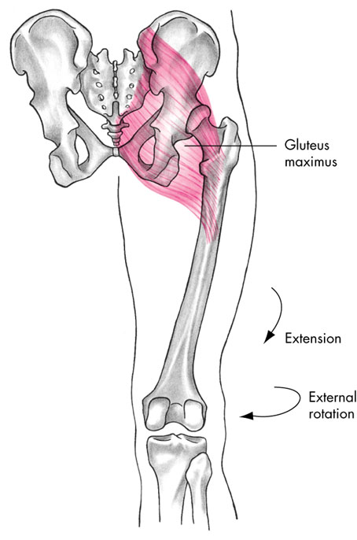
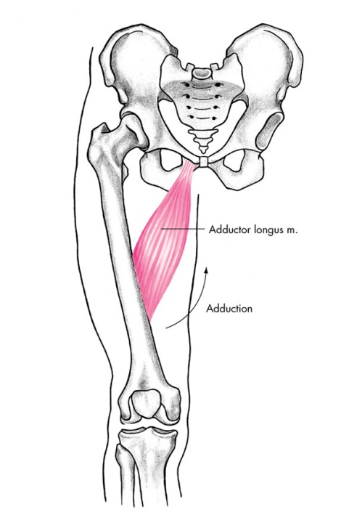
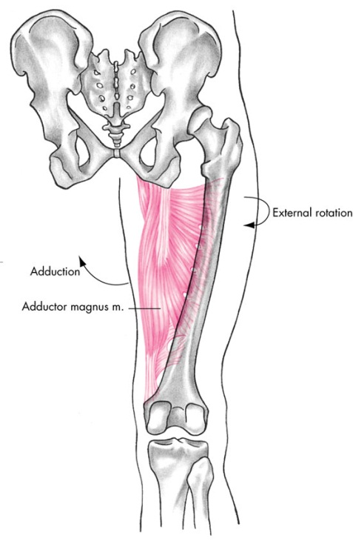
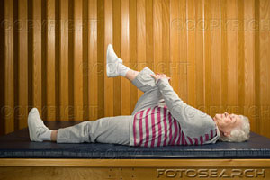
Single Knee to Chest
stretches adductor, gluteus maximus, lumbar spine

Slide 7
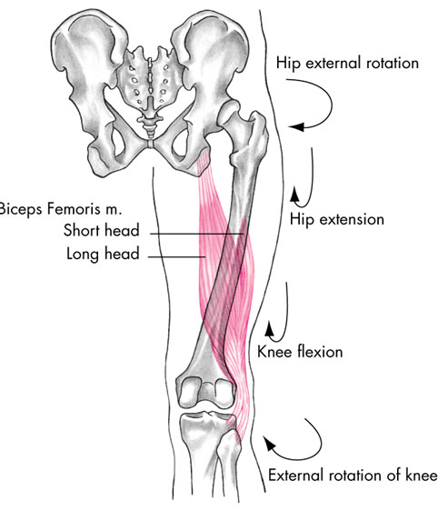
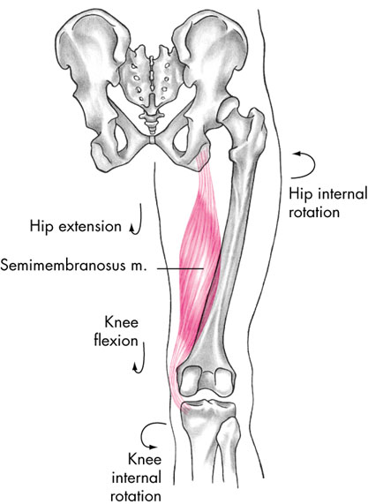
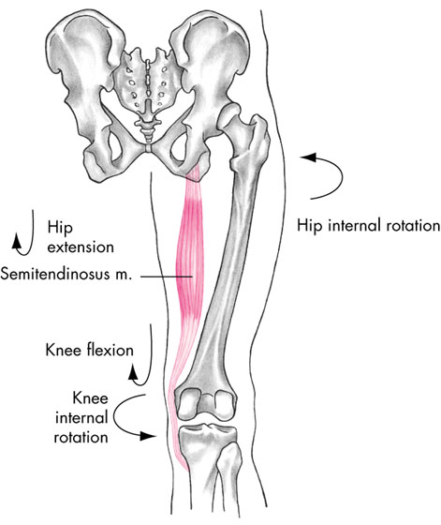
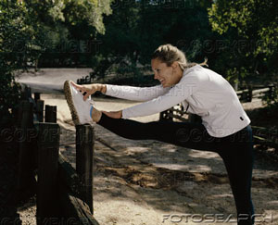
Straight Leg Raise
stretches hamstrings
tight hamstrings posteriorly rotate pelvis causing straightening of lumbar spine
this ⇑ stress on discs contributing to low back pain
tight hamstrings

Slide 8
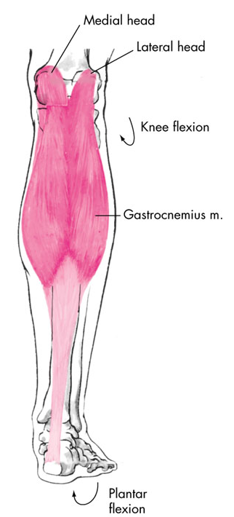
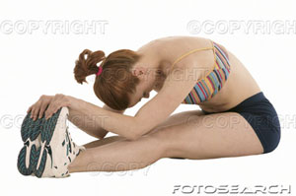
Gastrocnemuius Stretch
knees in extension
Soleus Stretch
knees slightly flexed

Slide 9
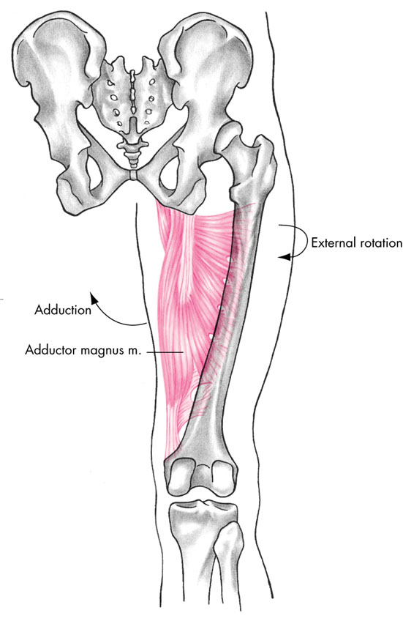
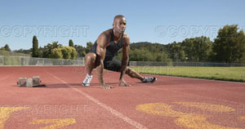
Adductor Stretch
⇓ risk of groin pulls

Slide 10
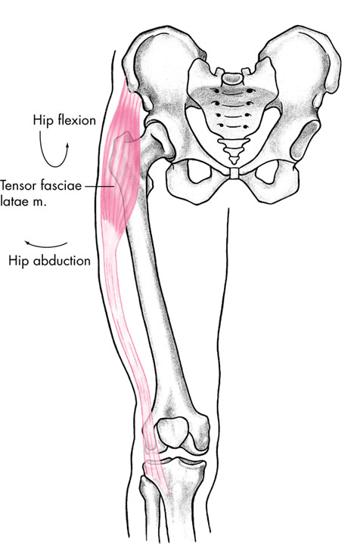
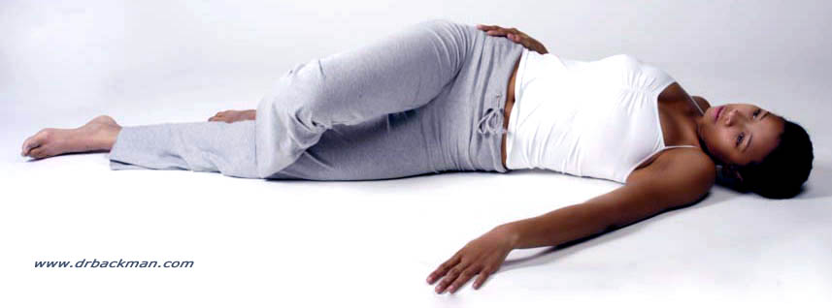
IT Band Stretch
⇓ risk IT Band syndrome, common in cyclists & runners moving only on sagital plane
IT Band rubs over lateral condyle of femur creating inflammation

Slide 11
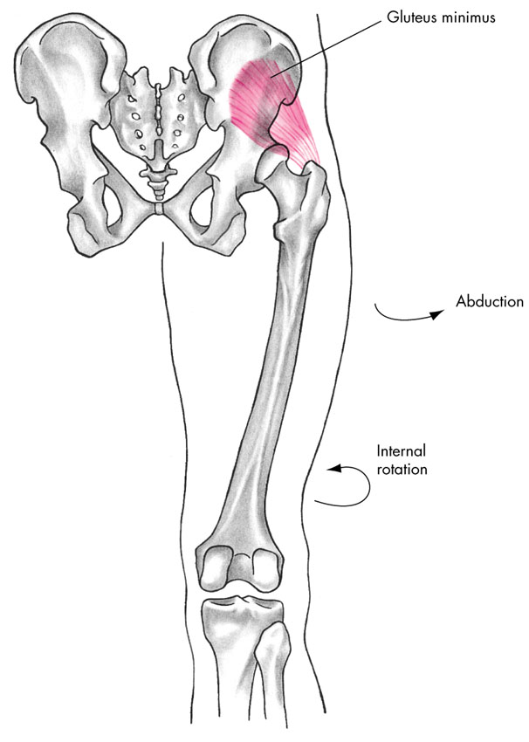
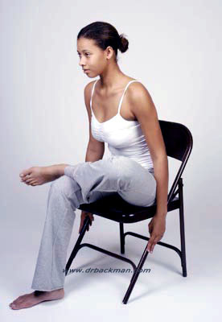
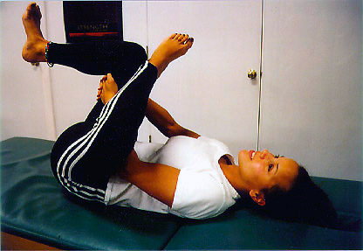
External Rotation Stretch
to stretch the internal rotators

Slide 12
Internal Rotation Stretch
to stretch the external rotators
piriformis
sciatic nerve runs very close to this muscle
tightness in piriformis may contribute to sciatic pain

Slide 13
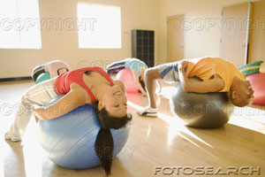
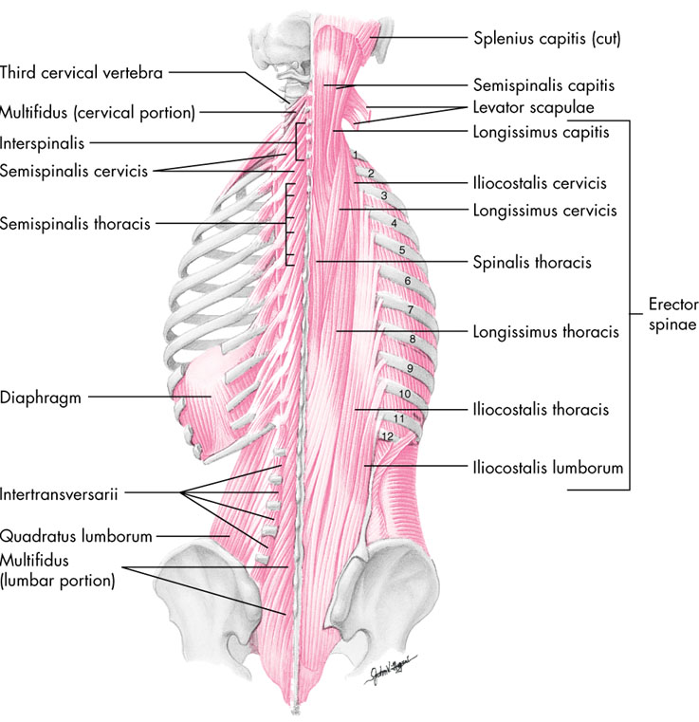
Lumbar Rotation Stretch
Lumbar Hyperextension Stretch

Slide 14
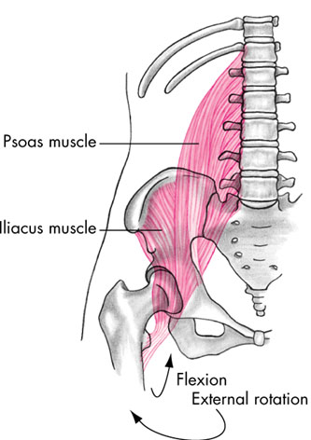
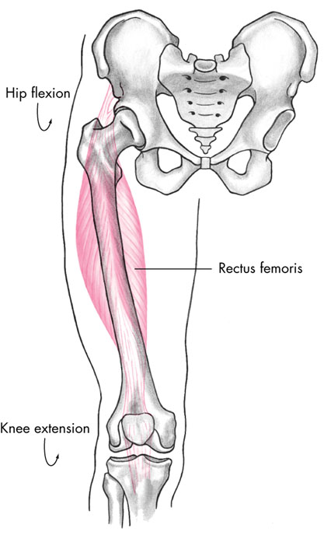
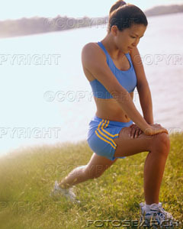
Hip Flexor Stretch
Stretches Iliopsoas
tight hip flexors cause an anterior rotated pelvis
this causes hyperextension of the lumbar spine and can contribute to low back pain
pressure on facet joints

Slide 15
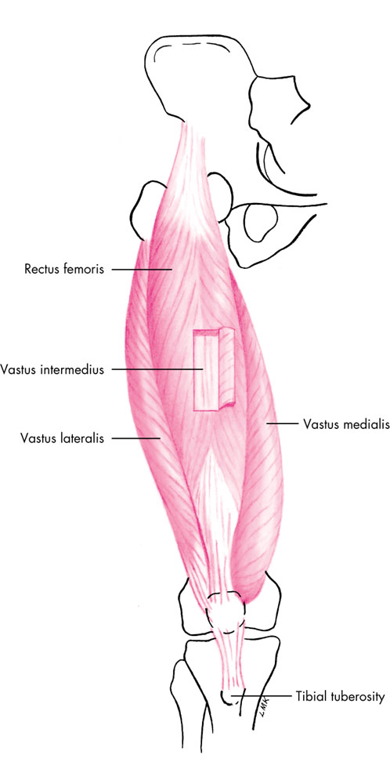
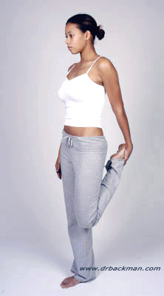
Quadriceps Stretch
keep pelvis posteriorly rotated
⇓ risk of quadriceps pull

Slide 16
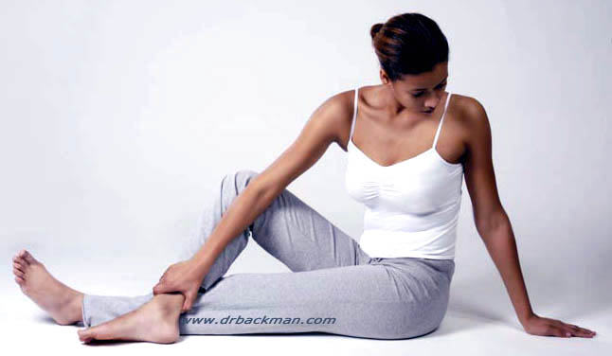
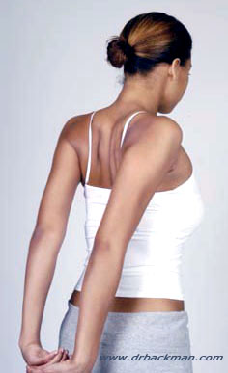

Slide 17
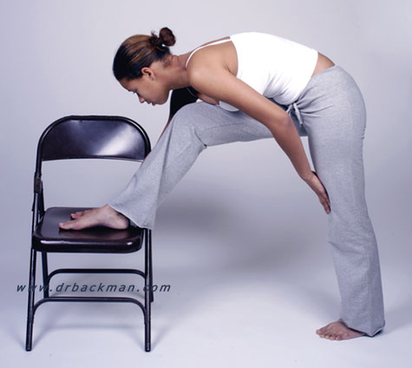

Slide 18
Abdominal Exercises
Effective sit-ups emphasis lumbar flexion of the abdominal muscles
Hip flexor muscles (e.g. iliopsoas) can also perform lumbar flexion

Slide 19
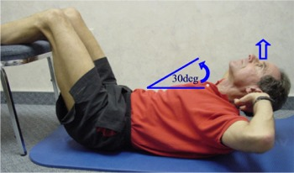
Abdominal Exercises
Flexing the knees neutralizes the hip flexor muscles
Stabilizing the feet increases the strength of the hip flexors

Slide 20
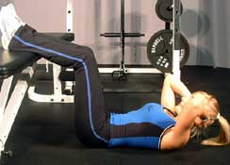
Crunches
Flex the knees and hip to 90 degrees
Don’t stabilize the feet
Arms at side; move them closer to the head to increase difficulty
If hands behind head, avoid over cervical flexion
Slowly perform lumbar flexion
Exhale during lumbar flexion
Abdominal muscles active during first half of lumbar flexion
Return until head touches the floor
Muscles: Upper rectus Abdominis (obliques, hip flexors)

Slide 22
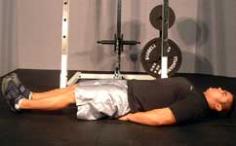
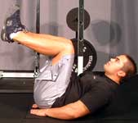
Leg Pull or Reverse Crunch
Action?
Lumbar flexion
Muscles:
Lower rectus abdominis, obliques, and hip flexors

Slide 23
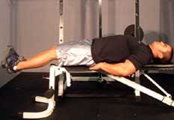
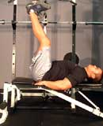
Leg Raises
Muscles: First, hip flexors then as the hips are raised off the ground, the rectus abdominis is more involved

Slide 24
Abdominal Exercises
Rectus Abdominis and Obliques dynamically contract only if actual waist flexion occurs.
With no waist flexion, Rectus Abdominis and External Oblique will only isometrically contract to stabilize the pelvis and waist during hip flexion.
It may be necessary to completely flex the hips before waist flexion is possible
ExRx

Slide 25
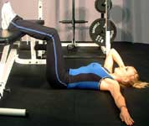
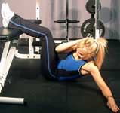
Abdominal Exercises
Muscles: Obliques (rectus abdominis and hip flexors)
Notice her right external oblique - rotation to the opposite side
Her left internal oblique - rotation to the same side

Slide 27
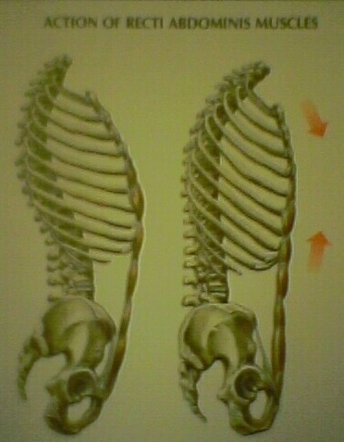
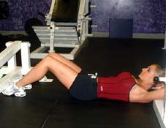
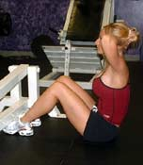
Sit-Ups
Muscles: Rectus abdominis (obliques and hip flexors)
Note: Flexing or “curling” the lumbar region emphasizes the rectus abdominis

Slide 28
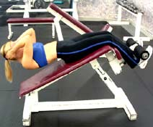
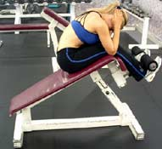
Incline Sit-ups
Increased resistance

Slide 29
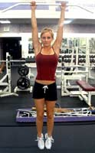
Leg Raise
Muscles: First, hip flexors. As the upper leg passes horizontal, rectus abdominis becomes more involved

Slide 30
Side Bends
Action?
Lateral Flexion
Muscles:
Quadratus Lumborum, Rectus Abdominis, and Obliques

Slide 31
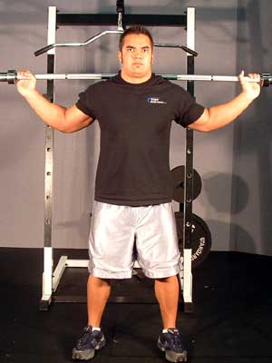

Slide 32
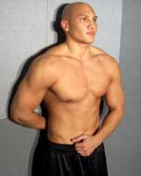
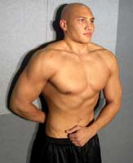
Transverse abdominis

Slide 34
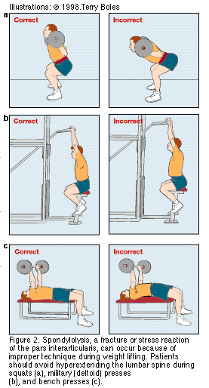

Slide 35
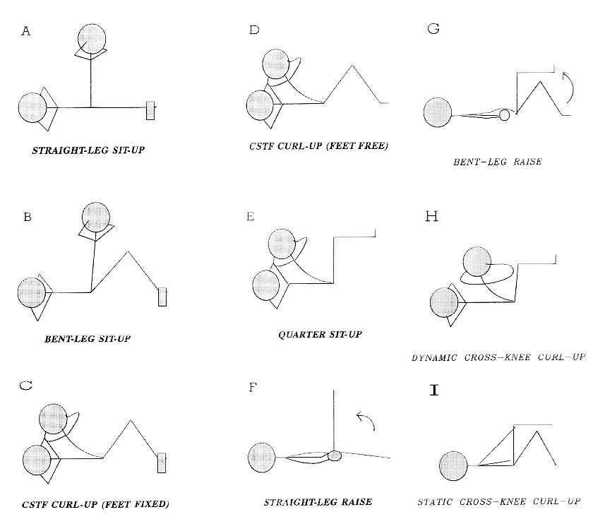
Abdominal Exercises
No one type of abdominal exercise is best.

