Slide 1
Rehabilitation of Ankle & Foot Injuries
Chapter 23

Slide 2
Functional Rehabilitation
Prolonged immobilization of ankle sprains is a common treatment error. Functional stress stimulates the incorporation of stronger replacement collagen.
The four components of rehabilitation are:
Range-of-motion rehabilitation
Progressive muscle-strengthening exercises
Proprioceptive training
Activity-specific training

Slide 3
Range of Motion
Achilles tendon stretch, nonweight-bearing. Use a towel to pull foot toward face. Pain-free stretch for 15 to 30 seconds; perform five repetitions; repeat three to five times a day. Maintain extremity in a nongravity position with compression.
Achilles tendon stretch, weight-bearing. Stand with heel on floor and bend at knees. Pain-free stretch for 15 to 30 seconds; perform five repetitions; repeat three to five times a day.
Alphabet exercises, Move ankle in multiple planes of motion by drawing letters of alphabet (lower case and upper case).
Repeat four to five times a day.Exercises can be performed in conjunction with cold therapy.

Slide 4
Muscle Strengthening
Isometric exercises, Resistance can be provided by immovable object (wall or floor) or contralateral foot. For each exercise, hold 5 seconds; do 10 repetitions; repeat three times a day. Strengthening exercises should only be done in positions that do not cause pain.
Plantar flexion, Push foot downward (away from head).
Dorsiflexion, Pull foot upward (toward head).
Inversion, Push foot inward (toward midline of body).
Eversion, Push foot outward (away from midline of body).
For each exercise, hold 1 second for concentric component and perform eccentric component over 4 seconds; do three sets of 10 repetitions; repeat two times a day.

Slide 5
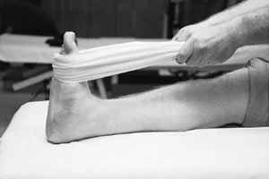
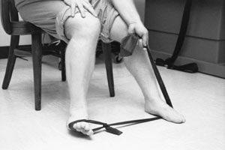
Muscle-Strengthening Exercises
FIGURE 8. Achilles tendon stretching using a towel.
FIGURE 9. Use of elastic tubing in strengthening exercises for eversion.

Slide 6
Muscle Strengthening
Toe curls and marble pickups, Place foot on a towel; then curl toes, moving the towel toward body. Use toes to pick up marbles or other small object. Two sets of 10 repetitions; repeat two times a day.Toe curls can be done throughout the day, at work or at home.
Toe raises, heel walks and toe walks,
Lift body by rising up on toes. Walk forward and backward on toes and heels.Three sets of 10 repetitions; repeat two times a day; progress walking as tolerated. Strengthening can occur from using the body as resistance in weight- bearing position.

Slide 7
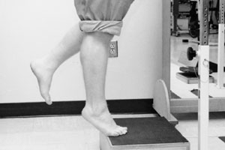
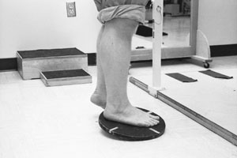
Muscle-Strengthening Exercises
FIGURE 10. Single-leg toe raises done on a step.
FIGURE 11. Single-leg wobble board exercise to increase proprioception.

Slide 8
Range of Motion
Range of motion must be regained before functional rehabilitation is initiated.
Regardless of weight-bearing capacity, Achilles tendon stretching should be instituted within 48 to 72 hours after the ankle injury because of the tendency of tissues to contract following trauma.
Once range of motion is attained, and swelling and pain are controlled, the patient is ready to progress to the strengthening phase of rehabilitation.

Slide 9
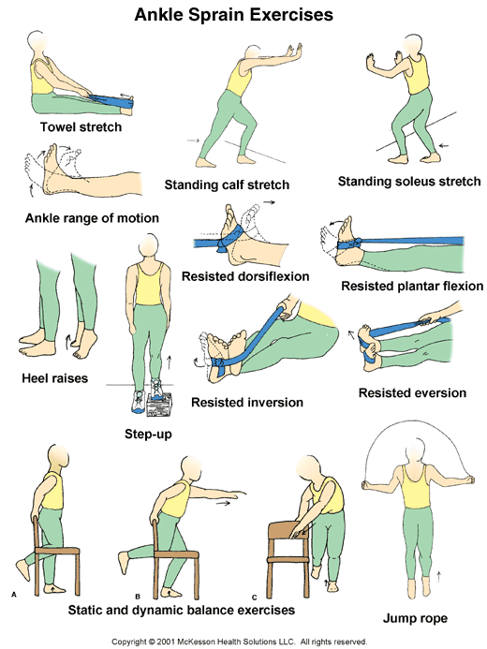
Rehabilitation/Strengthening

Slide 10
Training for Return to Activity
When walking a specified distance is no longer limited by pain, the patient may progress to a regimen of 50 percent walking and 50 percent jogging.
When this can be done without pain, jogging eventually progresses to forward, backward and pattern running. Circles and figure-eights are commonly employed for pattern running.
Although these routines are time-consuming, they represent the final phase and are essential for the recovery of ankle stability.

