Slide 1
Rehabilitation of Lower-Leg Injuries
Chapter 22

Slide 2
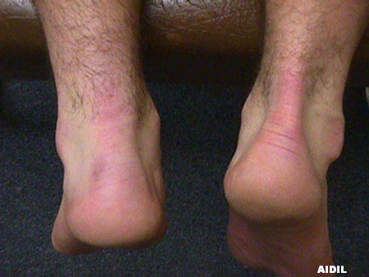
Inability to plantarflex

Slide 3
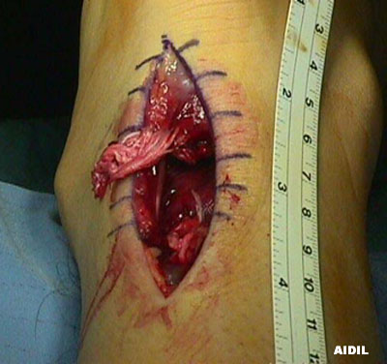
Before surgery

Slide 4
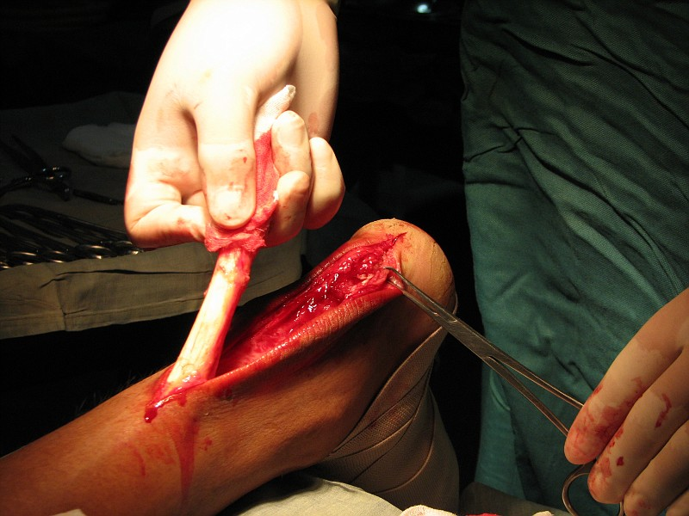

Slide 5
Rehabilitation
Physical Therapy
Stretching and flexibility exercise are key to helping your tendon heal without shortening and becoming chronically painful.
Ultrasound heat therapy improves blood circulation, which may aid the healing process.
Transcutaneous electrical nerve stimulation (TENS) is sometimes used and may provide pain relief for some people.
Massage helps you increase flexibility and blood circulation in the lower leg and can help prevent further injury.
Wearing a night brace keeps your leg flexed and prevents your Achilles tendon from tightening while you sleep. An Achilles tendon that chronically tightens at night is not able to heal properly.

Slide 6
Post Surgery Rehabilitation
Phase I- PWB(partial weight bearing) beginning 4 weeks post-op
Gait training (wean from heel lift after 2 weeks if applicable) Soft tissue massage and/or modalities as needed Exercises:
Towel calf stretch (without pain) Theraband exercises – dorsi and plantar flexion, inversion, eversion Sitting calf raises Straight leg raises BAPS in sitting Bike light if ROM (range of motion) allows May perform pool ex’s also
The patient may do this mainly as an independent program if appropriate
Progress to Phase II when:
-tolerates all Phase I without pain or significant increase in swelling -ambulates FWB (full weight bearing) without device -ROM for plantar flexion, inversion and eversion are normal -dorsi flexion is at approximately neutral

Slide 7
Post Surgery Rehab
Phase II (6-8 weeks post op)
Gait training Soft tissue work and/or modalities as needed Exercises:
Standing gastroc and soleus stretches Bike light to moderate resistance as tolerated Leg press:
quads bilateral to unilateral
calf raises (sub-maximal bilateral to unilateral)
Sitting calf raises to standing at (generally 8-10 weeks) BAPS board standing (with support as needed) Step ups Step downs Unilateral stance; balance activities with challenges if appropriate (such as ground clock) Mini-squats – bilateral to unilateral Stairmaster – short steps 4", no greater than level 4 if no pain or inflammation May continue pool if appropriate
May be 2X/wk or to independent as appropriate
Progress to Phase III when:
-cleared by physician -can do each of Phase II activities without pain or swelling -ROM equal bilaterally -able to do bilateral calf raise without difficulty and weight equal bilaterally -unilateral stance balance equal bilaterally

Slide 8
Post Surgery Rehab
Phase III (generally not before 10-12 weeks)
Frequency at discretion of therapist Gait normal without device Standing calf raises to unilateral (generally 16 weeks) Outdoor biking Full/maximal one leg PRE's [progressive resistance exercises] (generally at 16 weeks) Agility drills (generally not before 16-20 weeks. Should be discussed with physician first.) - jogging to running when pain-free -sport-specific; cutting, side shuffles, jumping, hopping

Slide 9
Return To Play
After surgery an athlete should not return to play until they meet the criteria for progression to Phase III.
Even after completing Phase III the athlete should return at the discretion of their doctor and/or physical therapist.

Slide 10
Prevention
Avoid activities that place excessive stress on your heel cords, such as hill-running and jumping activities (especially if done consistently).
If you notice pain during exercise, rest.
If one exercise or activity causes you persistent pain, try another.
Alternate high-impact sports, such as running, with low-impact sports, such as walking, biking or swimming.
Maintain a healthy weight.
Wear well-fitting athletic shoes with proper cushioning in the heels.

Slide 11
Prevention
To avoid reoccurrence of an Achilles tendon injury:
Use warm-up and cool down exercises and calf-strengthening exercises.
Apply ice to your Achilles tendon after exercise.
Alternate high-impact sports with low impact sports, so as not to overwork your Achilles tendons.

