Slide 1
Rehabilitation of Knee Injuries
Chapter 21

Slide 2
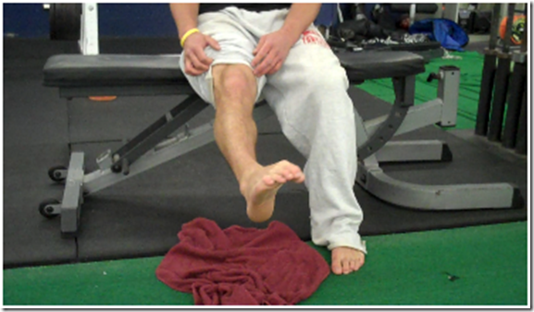
Knee Exercises
ANKLE ABC’s: Using the big toe as an imaginary pencil, write the letters of the alphabet moving only the ankle and foot. Try to make the letters as large as possible. Repeat as often as possible throughout the day.

Slide 3
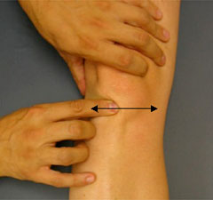
Knee Exercises
PATELLA MOBILIZATION: With leg straight and muscles relaxed, place two fingers on either side of the kneecap and gently move kneecap side-to-side for 1 - 2 minutes. Repeat, moving the kneecap up and down for 1 - 2 minutes. Repeat as often as possible

Slide 4
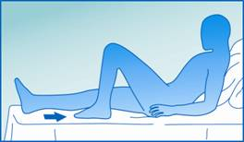
Knee Exercises
HEEL SLIDES: While sitting on a smooth surface, pull heel of injured leg toward buttocks, flexing knee as much as tolerable. Hold and straighten leg by sliding heel downward. Use hands to put pressure on leg above kneecap, trying to make the knee as straight as possible. Repeat 30 times, 2 - 3 times daily.

Slide 5
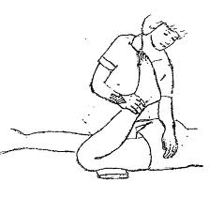
Knee Exercises
PASSIVE KNEE FLEXION: While seated in chair or table, gently push involved foot back as far as tolerable with opposite leg. Hold for 5 seconds and slowly relax. Repeat 30 times, 2 - 3 times daily.

Slide 6
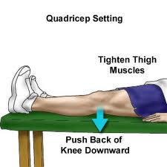
Knee Exercises
QUAD SETS: With leg as straight as possible, tighten thigh muscles, trying to pull kneecap toward hip. Hold for 10 seconds contracting the muscles as tight as possible. Relax and rest 2 seconds. Repeat as often as possible.

Slide 7
Knee Exercises
HAMSTRING STRETCH: While seated with legs straight and heels resting on a book or rolled up towel, slowly lean over involved leg touching toes with hands and nose to knee. Hold for 30 - 60 seconds and slowly return to start position. DO NOT BOUNCE! Repeat as often as possible.

Slide 8
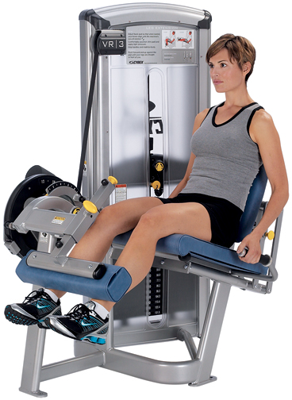
Knee Exercises
PROGRESSIVE RESISTANCE EXERCISE (PRE): Begin all PRE’s doing 3 sets of 10 repetitions. Upon completion of 3x10 with little difficulty, progress to 3x15 for the next session, then 3x20. When 3x20 can be completed with little difficulty, add 1 - 2 lbs. of resistance and return to 3x10. Work back up to 3x20 add another 1 - 2 lbs, and repeat cycle.

Slide 9
D.A.P.R.E. To Develop Strength
The athlete must perform some progressive resistive exercises on a regular basis if an increase of strength is desired
The D.A.P.R.E. technique takes advantage of the fact that strength can be redeveloped much more quickly than it was developed initially.
Patients perform maximal repetitions during their third and fourth sets, with the number or repetitions performed used as a basis for adjusting the resistance for the fourth set and next day, respectively.
Each side of the body should be worked independently
Prevents the injured limb from depending on the non-injured one
It establishes a functional strength-development goal for the injured side.

Slide 10
D.A.P.R.E.
Set | Portion of working weight used | Number of repetitions
1 | 1/2 | 10
2 | 3/4 | 6
3 | Full | Maximum*
4 | Adjusted | Maximum**
*The number of repetitions performed during the third set is used to
determine the adjusted working weight for the fourth set, according
to the guidelines in the next table
**The number of repetitions performed during the fourth set is used to
determine the adjusted working weight for the next day, according to
the guidelines in the next table

Slide 11
Adjustment of Working Weight
Number or repetitions performed during set | Fourth set* | Next day**
0-2 | Decrease 5-10 lb. and perform the set over | Keep the same
3-4 | Decrease 0-5 lb. | Increase 5-10 lb.
5-7 | Keep the same | Increase 5-15 lb.
8-12 | Increase 5-10 lb. | Increase 10-20 lb.
13 to… | Increase 10-15 lb.

Slide 12
Set | Portion of working weight used | Number of repetitions
1 | 1/2 | 10
2 | 3/4 | 6
3 | Full | Maximum*
4 | Adjusted | Maximum**
Number or repetitions performed during set | Fourth set* | Next day**
0-2 | Decrease 5-10 lb. and perform the set over | Keep the same
3-4 | Decrease 0-5 lb. | Increase 5-10 lb.
5-7 | Keep the same | Increase 5-15 lb.
8-12 | Increase 5-10 lb. | Increase 10-20 lb.
13 to… | Increase 10-15 lb.

Slide 13
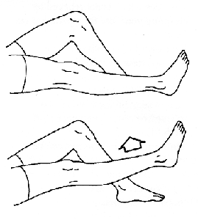
Knee Exercises
STRAIGHT LEG RAISES (SLR) — SUPINE: While lying on back or sitting with hips flexed less than 90 degrees, flex ankle to 90 degrees. Tighten thigh muscles and raise leg upward, keeping knee straight. Lift leg 12” - 18” off of floor and hold 1 second. Slowly lower leg to floor. Repeat and progress as detailed under PRE.

Slide 14
Knee Exercises
STRAIGHT LEG RAISES — ABDUCTION: Repeat process used for Supine SLR while lying on uninvolved side and raise injured leg 10 - 18” off floor. Repeat and progress as detailed under PRE(#7).

Slide 15
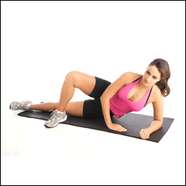
Knee Exercises
STRAIGHT LEG RAISES — ADDUCTION: Repeat process used for Supine SLR while lying on involved side and raise injured leg 6 - 12” off floor. Repeat and progress as detailed under PRE(#7).

Slide 16
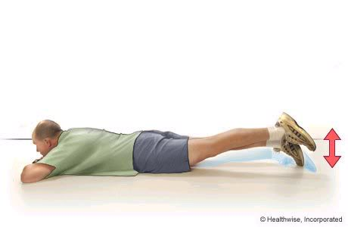
Knee Exercises
STRAIGHT LEG RAISES — PRONE: Repeat process used for Supine SLR while lying on stomach and raise injured leg 6 - 12” off floor. Repeat and progress as detailed under PRE(#7).

Slide 17
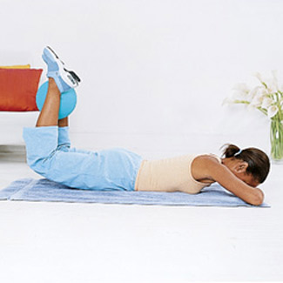
Knee Exercises
PRONE FLEXION: Lay on stomach and flex knee, bringing heel toward buttocks. Hold and slowly lower leg. Repeat and progress as detailed under PRE (#7).

Slide 18
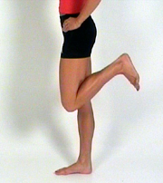
Knee Exercises
STANDING FLEXION: Standing, using an object for balance, flex knee, bringing heel up to buttocks. Keep thighs parallel. Hold and slowly lower leg. Repeat and progress as detailed under PRE (#7).

Slide 19
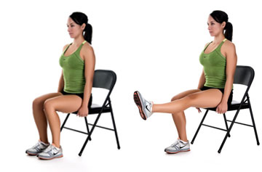
Knee Exercises
SEATED EXTENSION: In sitting position, slowly extend lower leg until straight. Hold, contracting thigh muscles as tight as possible, and slowly lower. Repeat and progress as detailed in PRE (#7).

Slide 20
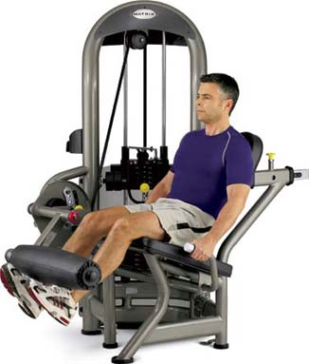
Knee Exercises
90 - 45 DEGREE EXTENSION: In sitting position, slowly extend lower leg to a 45 degree. angle. This can be seen when the shin is in line with the kneecap. Hold and slowly lower leg. Repeat and progress as detailed under PRE (#7).

Slide 21
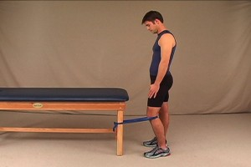
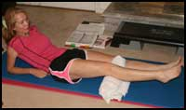
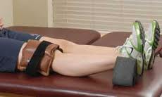
Knee Exercises
TERMINAL KNEE EXTENSION: Place a coffee or paint can under involved knee, allowing knee to bend about 30 degree. Slowly extend lower leg until it is straight and contract thigh muscles as tight as possible for 3 seconds. Slowly lower heel to floor. Repeat and progress as detailed in PRE (#7)

Slide 22
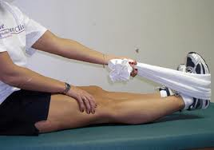
Knee Exercises
SEATED CORD EXTENSION: In sitting position with Sport Cord placed under ball of involved foot, extend knee against cord pushing down and away, to -5 degree. of full extension. Repeat 3x10, 3x15, 3x20 then progress by increasing cord density and returning to 3x10.

Slide 23
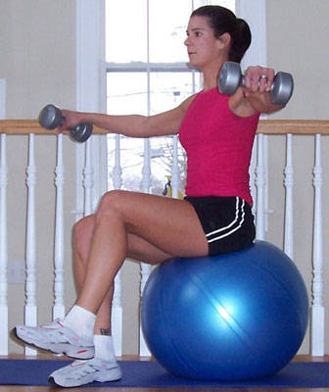
Knee Exercises
HIP FLEXION: Sit on edge of firm surface with feet resting on floor. Lift involved knee toward chest, while keeping knee comfortably bent. Hold and slowly lower. Repeat and progress as detailed in PRE (#7).

Slide 24
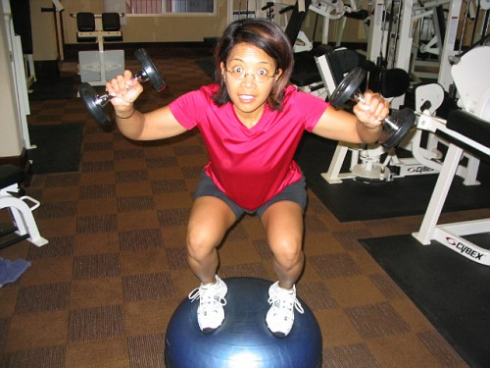
Knee Exercises
PARTIAL SQUATS: Standing with feet shoulder width apart and toes pointing slight outward, bend knees and slowly squat down. Maintain upright posture and do not allow thighs to go below parallel to floor. Hold and slowly return to start position and repeat. Progress by increasing reps to 3x20 then begin one-leg squats.

Slide 25
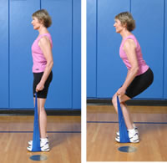
Knee Exercises
SPORT CORD SQUATS: Stand with heels on Sport Cord. Squat down and grasp Sport Cord handles stretching cord snugly. Slowly stand erect pulling on cord. Slowly return to squat position against cord. Repeat as directed and progress as for Seated Cord Extensions.

Slide 26
Knee Exercises
ONE LEG SQUATS: Using chair or table for balance assistance, slowly squat down on involved leg as far as possible — not to exceed 90 degrees of knee flexion. Then slowly raise up to start position and repeat as directed.

Slide 27
Knee Exercises
SIDE STEP UPS: Stand sideways with involved leg next to 3 - 6” step. Place involved foot on step and slowly lift body weight with involved leg. Slowly lower body back to start position, gently touching heel on ground, then repeat by slowly lifting body with involved leg. Repeat as by increasing repetitions for 3 x 10 to 3 x 15 to 3 x 20, increase step height 2 - 3” begin with 3 x 10 reps, increasing to 3 x 20.

Slide 28
Knee Exercises
FRONT STEP UPS: Stand directly behind 4 - 6” step or box. Step up on box with involved leg followed by uninvolved leg. Step back down with involved leg followed by uninvolved leg. Repeat as directed, increasing reps and box height as directed in Side Step Ups.

Slide 29
Knee Exercises
BALL SQUEEZE: Seated on edge of chair, place an 8 - 10” rubber ball between knees. Slowly contract inner thigh muscles, squeezing ball as tightly as possible, hold for 5 - 10 seconds. Relax and repeat as directed.

Slide 30
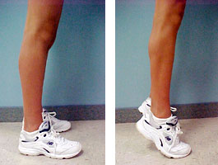
Knee Exercises
HEEL RAISES: Stand with feet shoulder width apart and toes pointed forward. Raise up on toes, lifting heels off floor as high as possible. Hold for one second and slowly lower to start position. Progress by increasing reps, placing balls of feet on 2 - 4” board (elevated), then progressing to one-leg calf/heel raises.

Slide 31
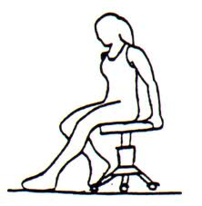
Knee Exercises
CHAIR WALK: Sit on a rolling chair or stool. Reach out in front of body as far as possible with involved heel. Slowly pull body and chair toward heel and repeat with opposite leg. Fully extend leg on each cycle and DO NOT EXCEED 90 DEGREES OF KNEE FLEXION. Repeat as directed.

Slide 32
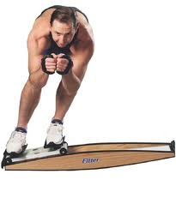
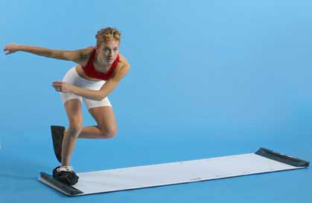
Knee Exercises
SLIDE BOARD: Begin at one end of slide board with knees bent and one foot pressed against block. Maintaining a squatting position, use outside leg to push body sideways across board, sliding to opposite side. Bring both feet together when opposite block is reached and repeat.

Slide 33
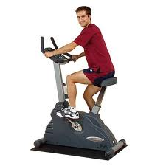
Knee Exercises
STATIONARY BICYCLING: Adjust seat height so that legs are almost straight at the bottom pedal position. Tension should provide low to moderate resistance. Ride for 10 - 20 minutes. Progress by lowering seat height as tolerable and increasing resistance and time.

Slide 34
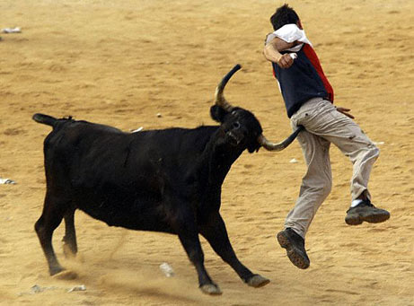
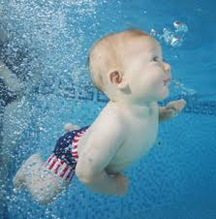
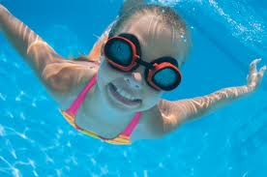
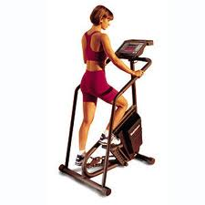
Knee Exercises
SWIMMING/RUNNING/STAIRCLIMBER: These activities may be beneficial to your knee rehabilitation.

