Slide 1
Rehabilitation of Wrist, Hand, & Finger Injuries
Chapter 19

Slide 2
Rehabilitation of the Forearm, Wrist, Hand and Fingers
General Body Conditioning
Must maintain pre-injury level of conditioning
Cardiorespiratory, strength, flexibility and neuromuscular control
Many exercise options (particularly lower extremity)
Joint Mobilizations
Wrist and hand respond to traction and mobilization techniques

Slide 3
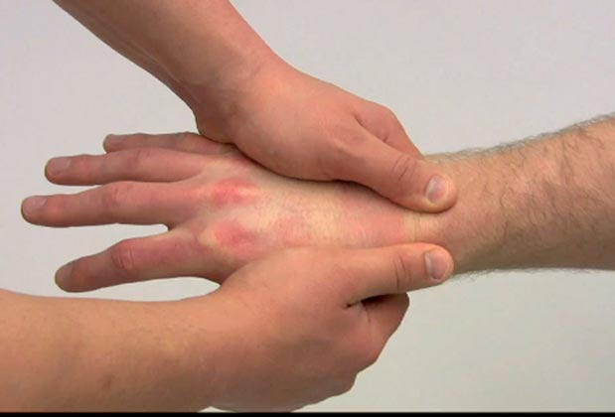
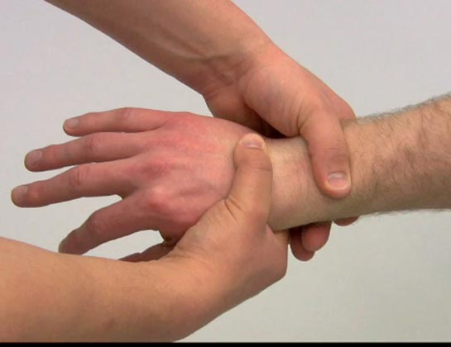
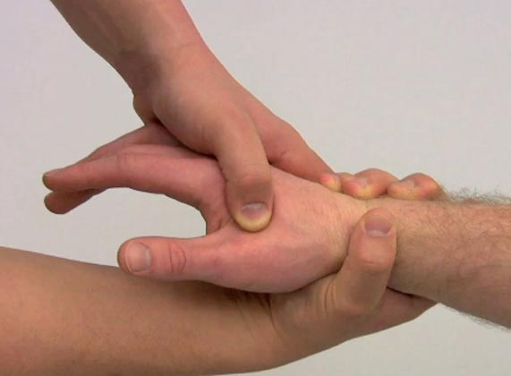
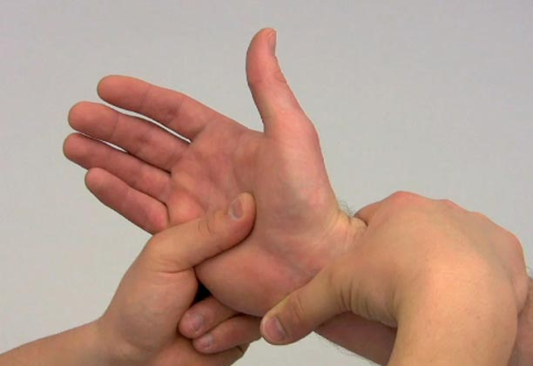
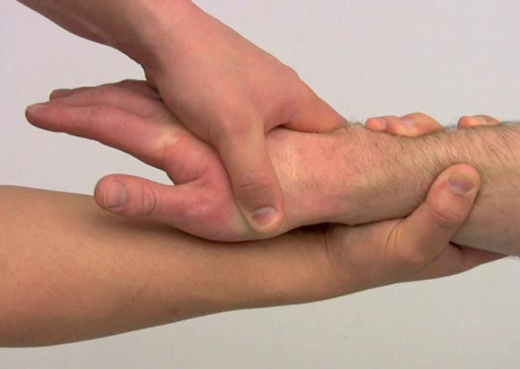
Joint Mobilization (cont.)
Can be used to increase specific ranges of motion

Slide 4
Flexibility
Full pain free ROM is a major goal of rehabilitation
The program should include active assisted and active pain free stretching
Strength
Exercises should not aggravate condition or disrupt healing process
A variety of exercises are available for strength (wrist and hand)

Slide 5
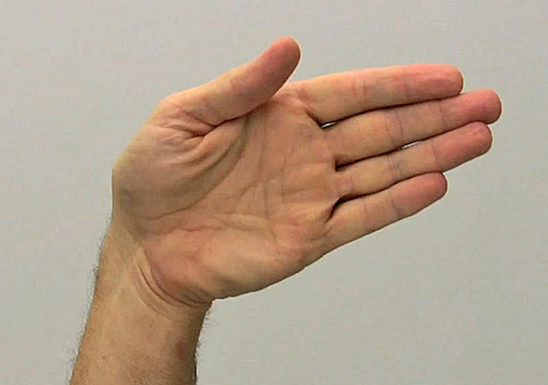
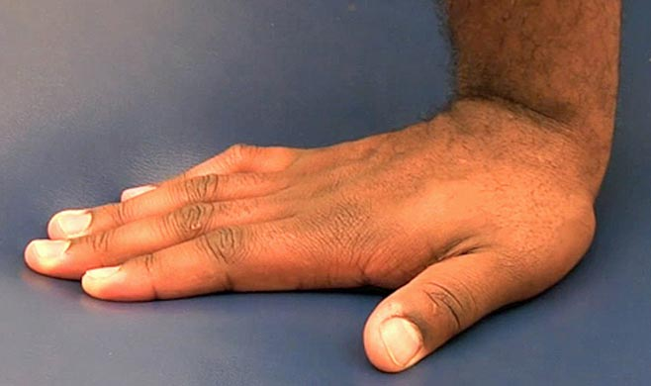
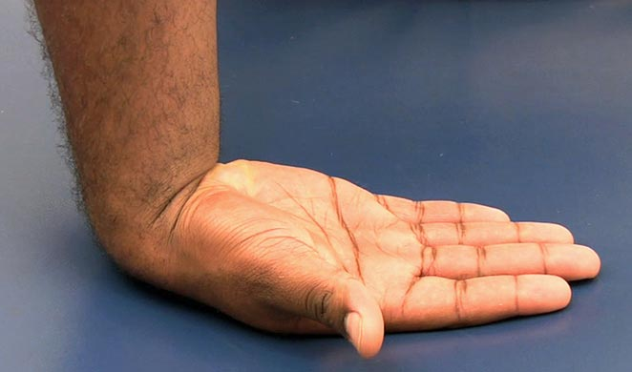
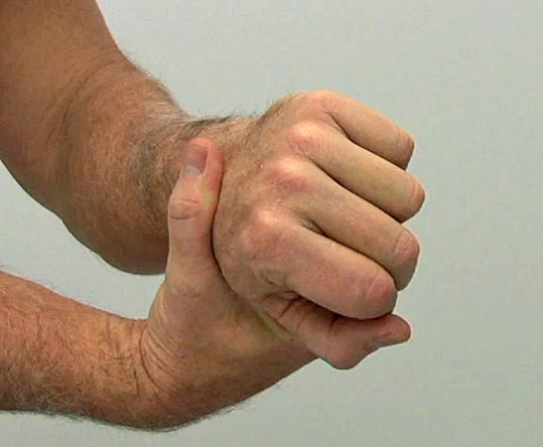
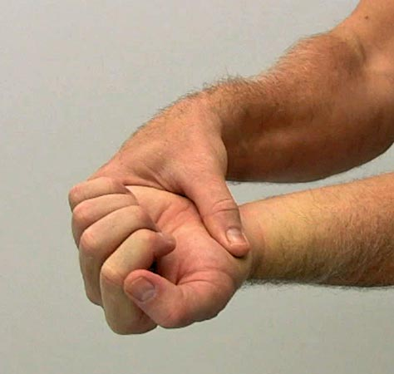
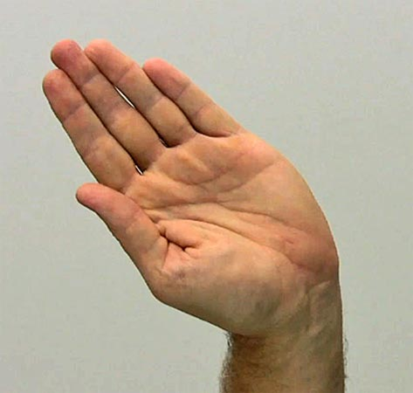
Flexibility Exercises

Slide 6
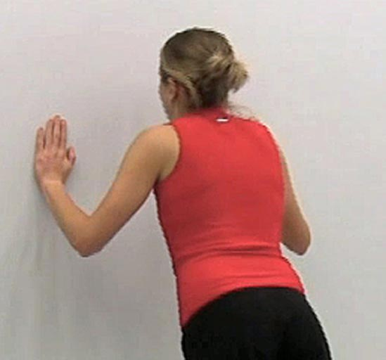
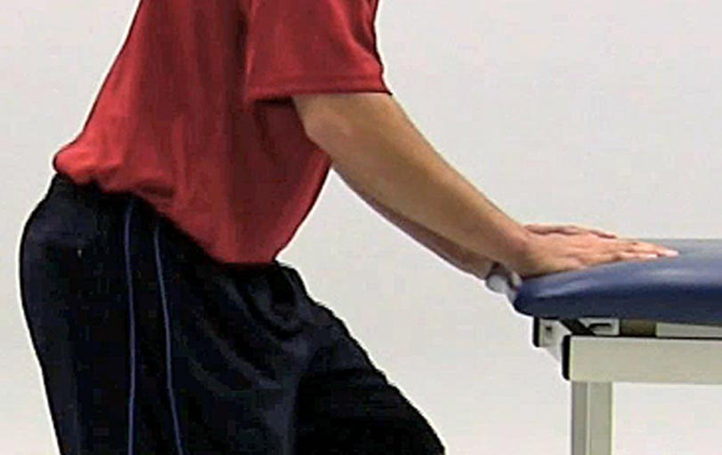
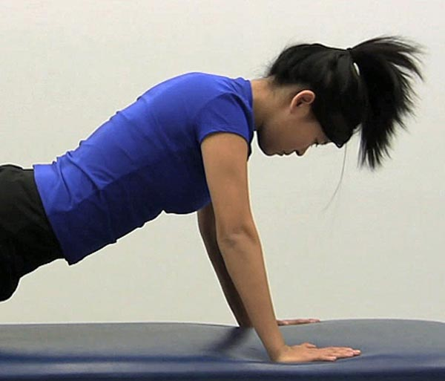
Flexibility Exercises

Slide 7
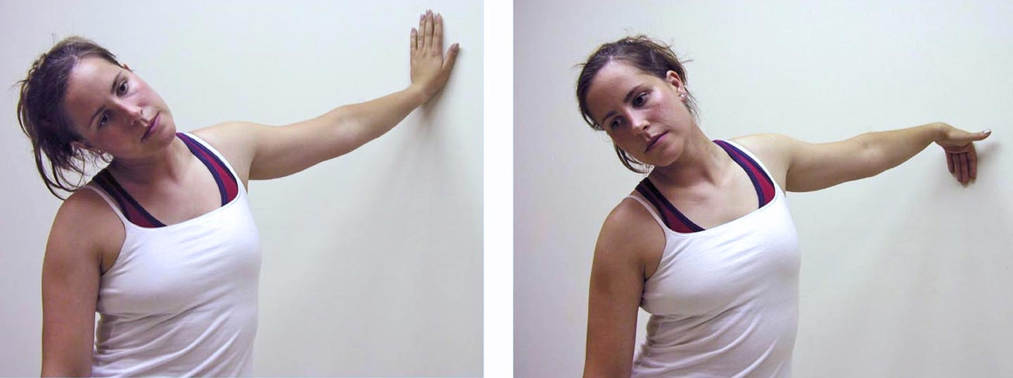
Neural Tension Exercises

Slide 8
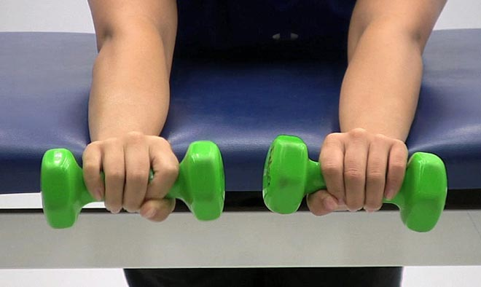
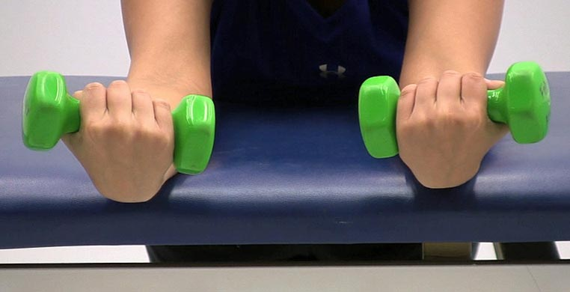
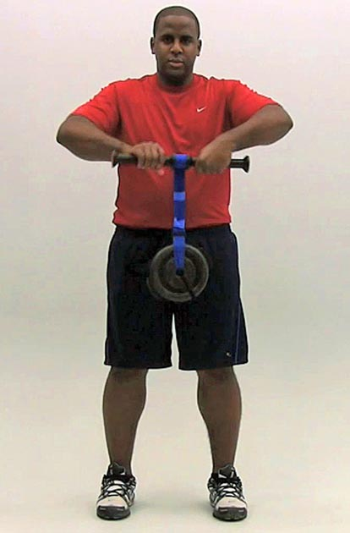
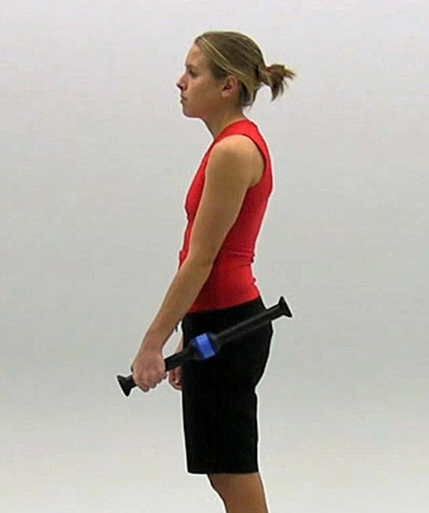
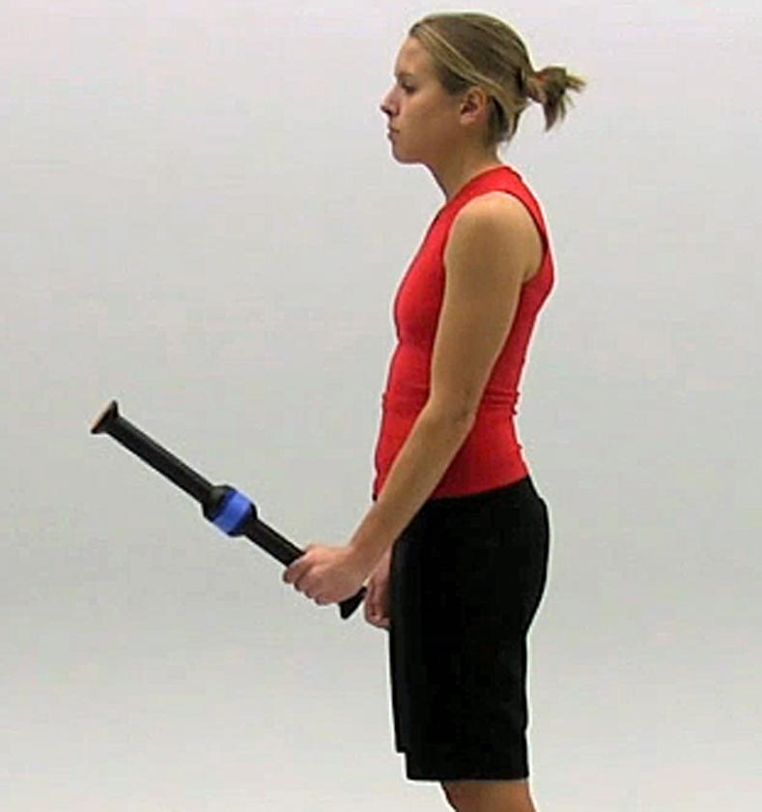
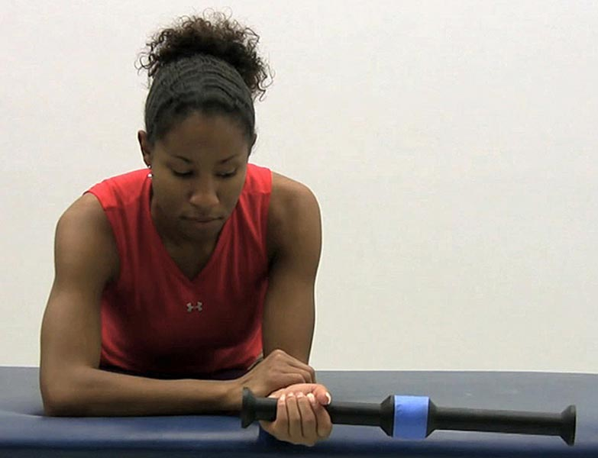
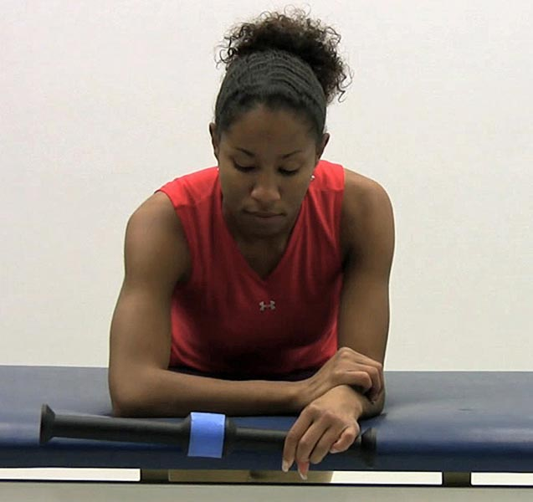
Strengthening Exercises

Slide 9
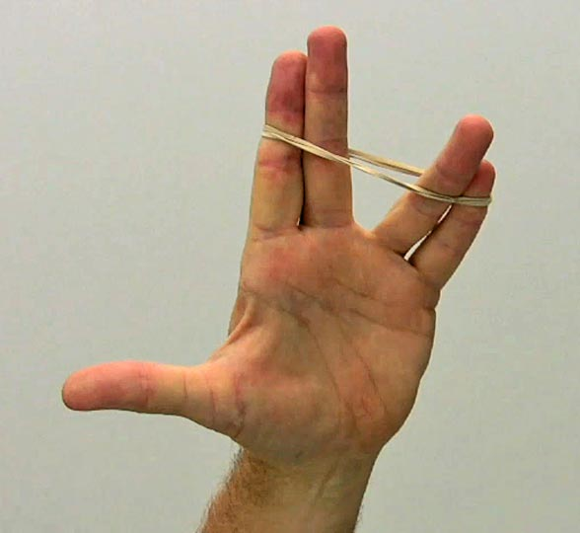
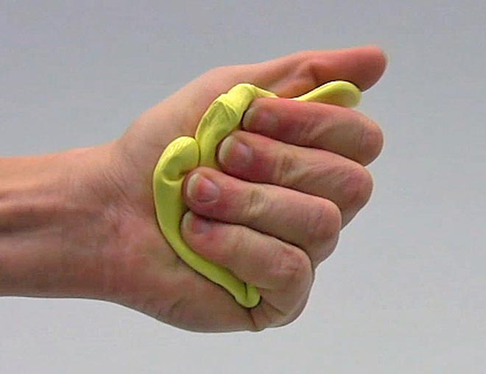
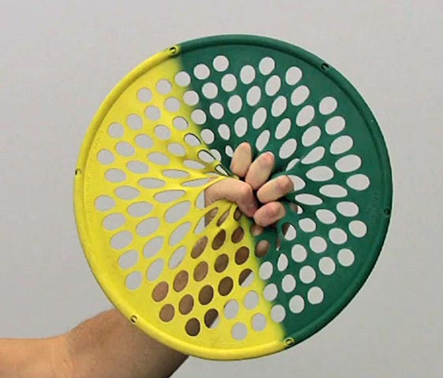
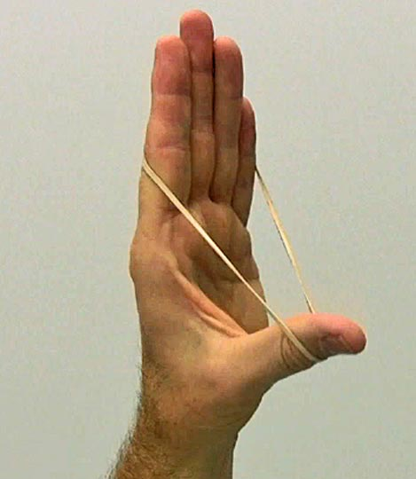
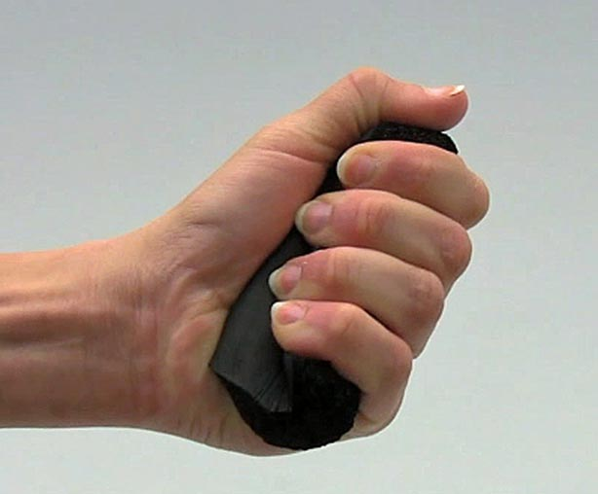
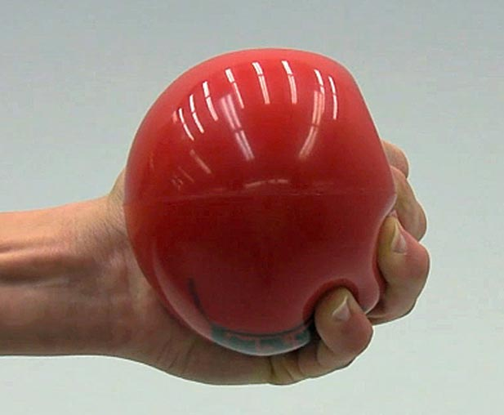
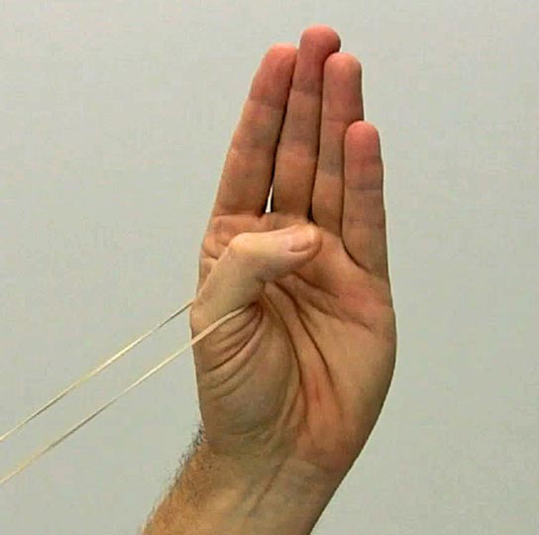

Slide 10
Neuromuscular Control
Hand and fingers require restoration of dexterity
Pinching, fine motor activities (buttoning buttons, tying shoes, and picking up small objects)
It is important to incorporate functional activities designed to restore patient’s ability to perform daily activities

Slide 11
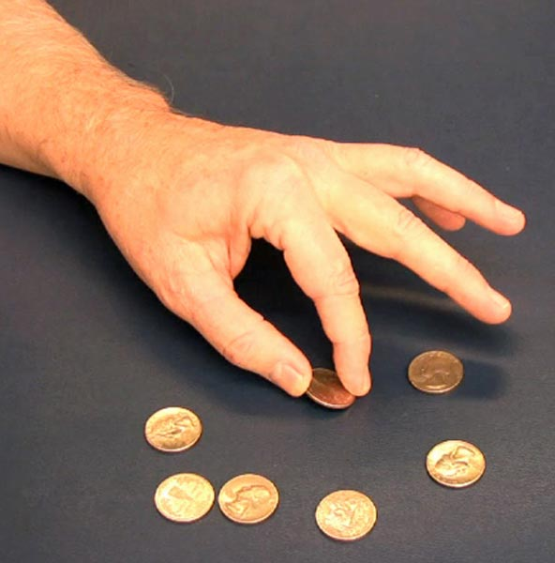
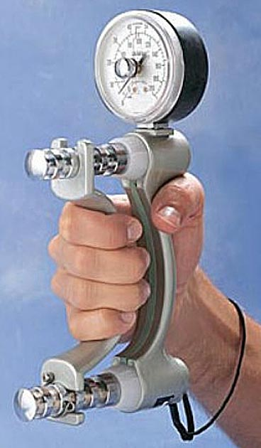
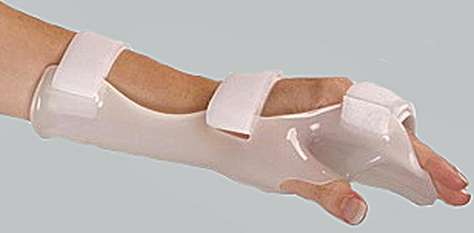
Return to Activity
Grip strength must be equal bilaterally, full range of motion and dexterity
Thumb has unique strength requirements
A variety of customizable bracing and splinting devices are available to protect injured wrist and hand

