Slide 1
Drugs For Relaxing Skeletal Muscle
Chapter 8

Slide 2
Muscle Spasm and Spasticity
Spasticity is a central nervous system dysfunction
Spasticity is technically not a disease process but a result of motor interruption (lesion), typically in the upper motor complex of the central nervous system

Slide 3
Muscle Spasm and Spasticity - Continued
A muscle stretch reflex is exaggerated in the individual’s limb or limbs
Rapid lengthening of the affected muscle results in a contraction of the stretched muscle
Spasticity is more commonly associated with the cerebral palsy or para/quadriplegia and is considered a more permanent disorder

Slide 4
Muscle Spasm
Tension developed in muscle spasm is involuntary and the athlete is unable to completely relax the muscle
This muscle spasm will create pain impulses from the muscle to the CNS. Increases in pain = increases in spasm (pain-spasm-pain cycle)

Slide 5
Muscle Spasm - Continued
Chronic muscle spasm can result in muscle atrophy in the specific muscle or muscle group

Slide 6
Muscle Relaxant Drugs
Centrally Acting
The exact mechanism of action of skeletal muscle relaxants is not well known at this time.
The use of these drugs may result in a mild general sedative effect producing an overall relaxation of the entire athlete.

Slide 7
Muscle Relaxant Drugs - Continued
It is suggested that Centrally Acting drugs create a sedative effect, which allows the athlete to relax, rest, and allow the muscle to repair itself, thus reducing the amount of muscle spasm the athlete experiences
Muscle relaxants are usually combined with an analgesic — aspirin or acetaminophen

Slide 8
Drugs Commonly Used to Treat Skeletal Muscle Spasms
Carisoprodol
Soma®
Chlorzaxazone
Parafon Forte®
Cyclobenzaprine
Flexeril®
Diazapam
Valium®
Orphenadrine citrate
Norflex®
350 mg TID
Onset 30 min.
Duration 4 to 6 hrs.
250–750 mg TID or QID
Onset < 60 min.
Duration 3 to 4 hrs.
10 mg TID
Onset <60 min.
Duration 12-24 hrs.
2–10 mg TID or QID
Onset 15 to 45 min.
Duration = Variable
100 mg BID
Onset < 60 min.
Duration 4 to 6 hrs.

Slide 9
Adverse Effects
Main adverse effect is drowsiness
Muscle relaxants are known to be addictive

Slide 10
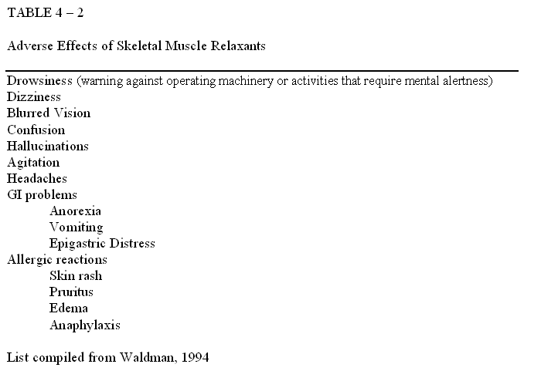
Adverse Effects - Continued

Slide 11
Specific Principles to Remember
Skeletal muscle relaxants do have a depressing effect on the CNS
Have an onset of action between 30 and 60 minutes
Duration of action varies among the drugs
Effect how the athlete participates in activity or rehabilitation – time/effort

Slide 12
Implications for Activity
Remind the athlete of the mild general sedative effect producing an overall relaxation
May result in an inability of the athlete to practice or compete due to being tired or even sleepy from the medication
The combination of skeletal muscle relaxants with alcohol or other CNS depressants can be dangerous or even lethal to the athlete

Slide 13
Physical Activity Implications
Need to schedule rehabilitation around peaks in the therapeutic window
Need to incorporate modalities into the treatment regimen – not just a drug-induced sedation

