Slide 1
Drugs for Treating Pain
Chapter 7

Slide 2
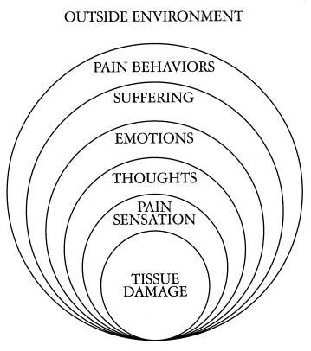
Perception of Pain
Emotion
Social and environmental context
Socio-cultural background
Beliefs
Attitudes
Personal expectations
Physical perturbations
Psychological recognition

Slide 3
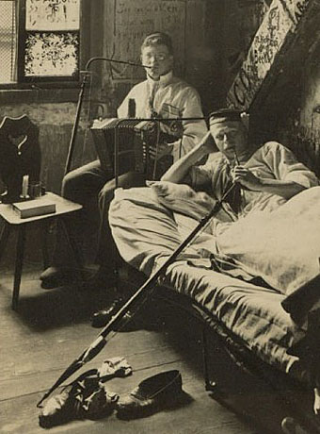
Perception of Pain - Terminology
Analgesic
  A drug or medicine given to reduce pain without resulting in loss of consciousness
  Analgesics are sometimes referred to as painkiller medications
Opiates
  Opium , Heroin, codeine, & morphine
  Opium appears either as dark brown chunks or in powder form, and is generally eaten or smoked
  Heroin usually appears as a white or brownish powder, which is dissolved in water for injection
  Most street preparations of heroin contain only a small percentage of the drug, as they are diluted with sugar, quinine, or other drugs and substances
  Other opiate analgesics appear in a variety of forms, such as capsules, tablets, syrups, elixirs, solutions, and suppositories

Slide 4
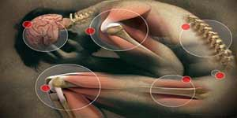
Perception of Pain - Terminology
Opioids
  Most often prescribed to treat pain
  Central nervous system (CNS) depressants, which are used to treat anxiety and sleep disorders
  Prescribed to treat the sleep disorder narcolepsy and attention-deficit hyperactivity disorder (ADHD)
Narcotic Analgesic
  Drugs used to relieve pain
  Relief induced by analgesics occurs either by blocking pain signals going to the brain or by interfering with the brain's interpretation of the signals
  Does not produce anesthesia or loss of consciousness

Slide 5
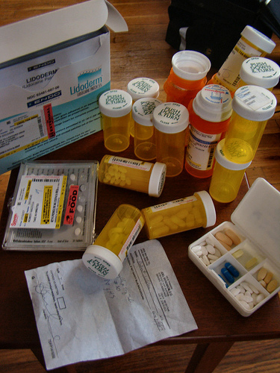
Perception of Pain - Terminology
Narcotic
  Depress breathing and other brain centers
  Relieves pain and anxiety
  Depresses all body systems

Slide 6
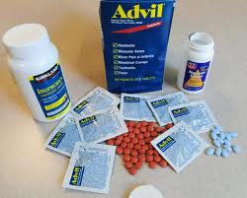
NSAIDs
NSAIDs (nonsteroidal anti-inflammatory drugs)
  NSAIDs work by reducing inflammation
  They block a key enzyme of inflammation called cyclooxygenase, which converts arachidonic acid to prostaglandins and leukotrienes
  Prostaglandins cause local inflammation

Slide 7
NSAIDs
Acetaminophen
  Tylenol is most common
  Acetaminophen is used to relieve mild to moderate pain from headaches, muscle aches, menstrual periods, colds and sore throats, toothaches, backaches, and reactions to vaccinations (shots), and to reduce fever
  May also be used to relieve the pain of osteoarthritis (arthritis caused by the breakdown of the lining of the joints)
  In a class of medications called analgesics (pain relievers) and antipyretics (fever reducers)
  Works by changing the way the body senses pain and by cooling the body
Comes as a tablet, chewable tablet, capsule, suspension or solution (liquid), drops (concentrated liquid), powder, extended-release (long-acting) tablet, and orally disintegrating tablet (tablet that dissolves quickly in the mouth), to take by mouth, with or without food
Also comes as a suppository
Side effects can be serious
  Rash
  Hives
  Itching
  Swelling of the face, throat, tongue, lips, eyes, hands, feet, ankles, or lower legs
  Hoarseness
  Difficulty breathing or swallowing

Slide 8
Opioid Analgesics – History
Opium is extracted from poppy seeds (Paper somniforum)
Used for thousands of years to produce:
  Euphoria
  Analgesia
  Sedation
  Relief from diarrhea
  Cough suppression
Used medicinally and recreationally from early Greek and Roman times
Opium and laudanum (opium combined with alcohol) were used to treat almost all known diseases
Morphine was isolated from opium in the early 1800’s and since then has been the most effective treatment for severe pain
Invention of the hypodermic needle in 1856 produced drug abusers who self administered opioids by injection
Controlling the widespread use of opioids has been unsuccessful because of the euphoria, tolerance and physiological dependence that opioids produce
“opium” is a Greek word meaning “juice,” or the exudate from the poppy
“opiate” is a drug extracted from the exudate of the poppy
“opioid” is a natural or synthetic drug that binds to opioid receptors producing agonist effects

Slide 9
Opioid Analgesics – Effects
Sedation and anxiolysis
  Drowsiness and lethargy
  Apathy
  Cognitive impairment
  Sense of tranquility
Depression of respiration
  Main cause of death from opioid overdose
  Combination of opioids and alcohol is especially dangerous
Cough suppression
  Opioids suppress the “cough center” in the brain
Pupillary constriction
  pupillary constriction in the presence of analgesics is characteristic of opioid use
Nausea and vomiting
  Stimulation of receptors in an area of the medulla called the chemoreceptor trigger zone causes nausea and vomiting
  Unpleasant side effect, but not life threatening
Gastrointestinal symptoms
  Opioids relieve diarrhea as a result of their direct actions on the intestines
Other effects
  Opioids can release histamines causing itching or more severe allergic reactions including bronchoconstriction
  Opioids can affect white blood cell function and immune function

Slide 10
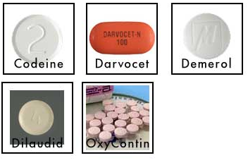
Opioid Analgesics – Mechanism of Action
Activation of peripheral nociceptive fibers causes release of substance P and other pain-signaling neurotransmitters from nerve terminals in the dorsal horn of the spinal cord
Release of pain-signaling neurotransmitters is regulated by endogenous endorphins or by exogenous opioid agonists by acting presynaptically to inhibit substance P release, causing analgesia

Slide 11

Opioid Analgesics - General Pharmacokinetics
LATENCY TO ONSET
  Oral (15-30 minutes)
  Intranasal (2-3 minutes)
  Intravenous (15 – 30 seconds)
  Pulmonary-inhalation (6-12 seconds)
DURATION OF ACTION – anywhere between 4 and 72 hours depending on the substance in question

Slide 12
Morphine
PHARMACOKINETICS
Routes of administration (preferred)
*Oral
latency to onset –(15 – 60 minutes )
* it is also sniffed, swallowed and injected.
* duration of action – ( 3 – 6 hours)
* First-pass metabolism results in poor
availability from oral dosing.
* 30% is plasma protein bound
EFFECTS AND MEDICAL USES
*symptomatic relief of moderate to severe pain
*relief of certain types of labored breathing
*suppression of severe cough (rarely)
*suppression of severe diarrhea

Slide 13
Hydromorphone
PHARMACOKINETICS
*Routes of administration (Preferred)
*Oral
*latency to onset (15 – 30 minutes)
*Intravenous
*Duration of Action (3-4 hours)
*Peak effect (30-60 minutes)
PROPERTIES AND EFFECTS
* potent analgesic like morphine but is 7-10
times as potent in this capacity.
*used frequently in surgical settings for moderate to
severe pain. (cancer, bone trauma, burns, renal colic.)

Slide 14
Fentanyl
Pharmacokinetics
Routes of Administration
* Oral, and transdermal (possibly intravenous)
*Highly lipophilic
*latency to onset (7-15 minutes oral; 12-17 hours
transdermal
*duration of action ( 1-2 hours oral; 72 transdermal)
*80 – 85% plasma protein bound
*90 % metabolized in the liver to inactive metabolites
Other properties
* 80 times the analgesic potency of morphine
and 10 times the analgesic potency of
hydromorphone
*most effective opiate analgesic

Slide 15
Dependence
Physiological dependence occurs when the drug is necessary for normal physiological functioning – this is demonstrated by the withdrawal reactions
Withdrawal reactions are usually the opposite of the physiological effects produced by the drug

Slide 16
Withdrawal Reactions
Acute Action
Analgesia
Respiratory Depression
Euphoria
Relaxation and sleep
Tranquilization
Decreased blood pressure
Constipation
Pupillary constriction
Hypothermia
Drying of secretions
Reduced sex drive
Flushed and warm skin
Withdrawal Sign
Pain and irritability
Hyperventilation
Dysphoria and depression
Restlessness and insomnia
Fearfulness and hostility
Increased blood pressure
Diarrhea
Pupillary dilation
Hyperthermia
Lacrimation, runny nose
Spontaneous ejaculation
Chilliness and “gooseflesh”

Slide 17
Caffeine
It is the most popular drug used by humans.
It is in many products used daily by adults and children.
Coffee is the major source of caffeine but different countries get it from different sources.
  Europe, N. America, N. Africa – Coffee
  W. Africa- Kola Nuts
  Mexico, Central & South America, N. America, Switzerland-Cocoa Plant
  Asia, UK, Ireland, N. America, Old USSR- Tea
  Brazil – Mate (type of tea)- Largest coffee producer

Slide 18
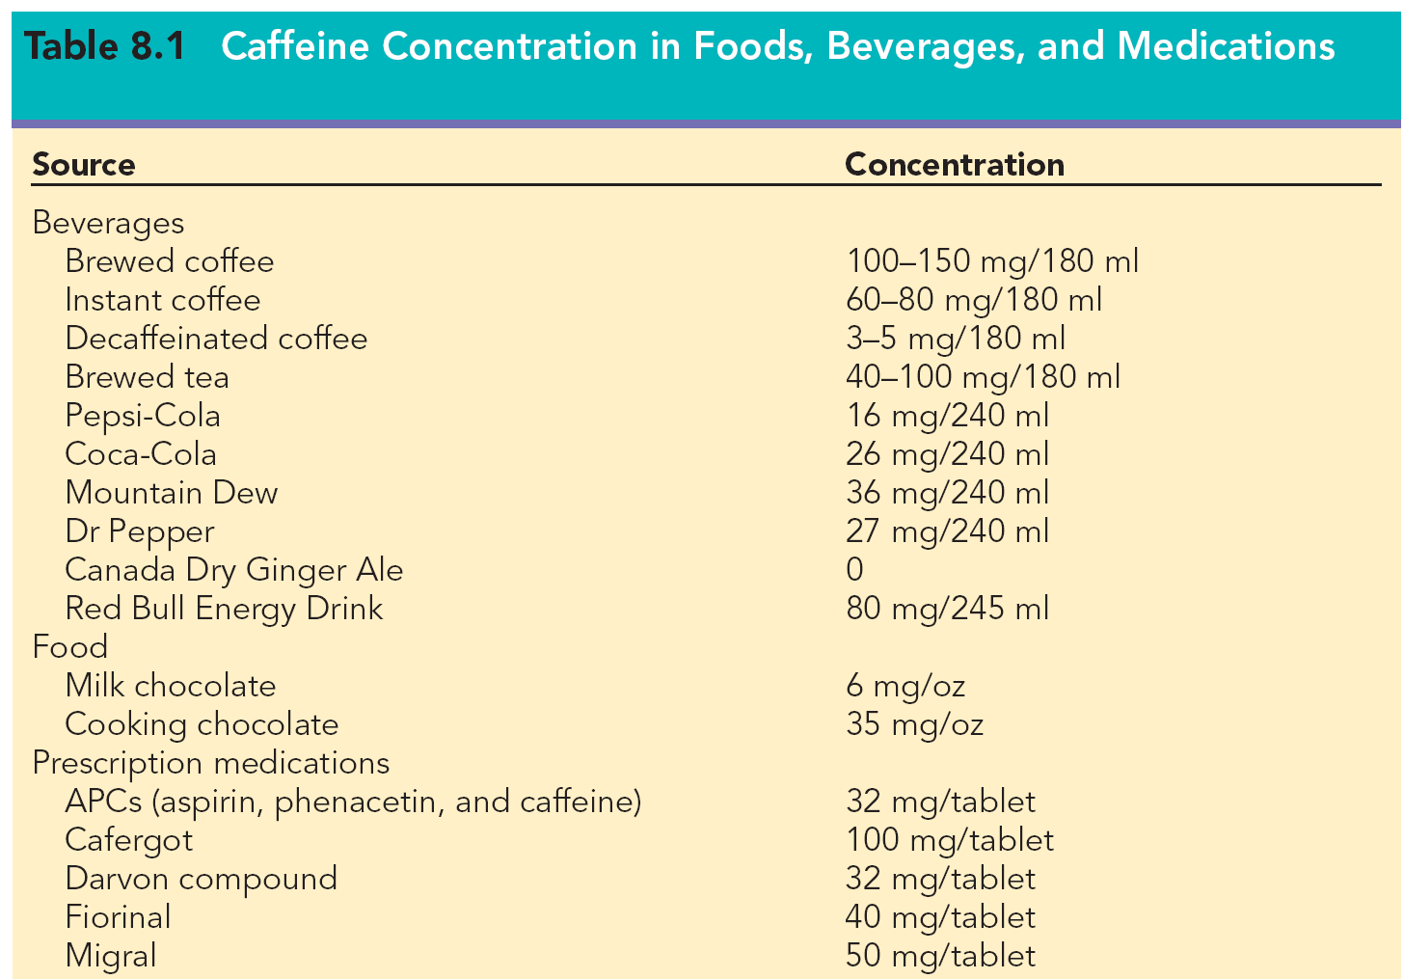

Slide 19
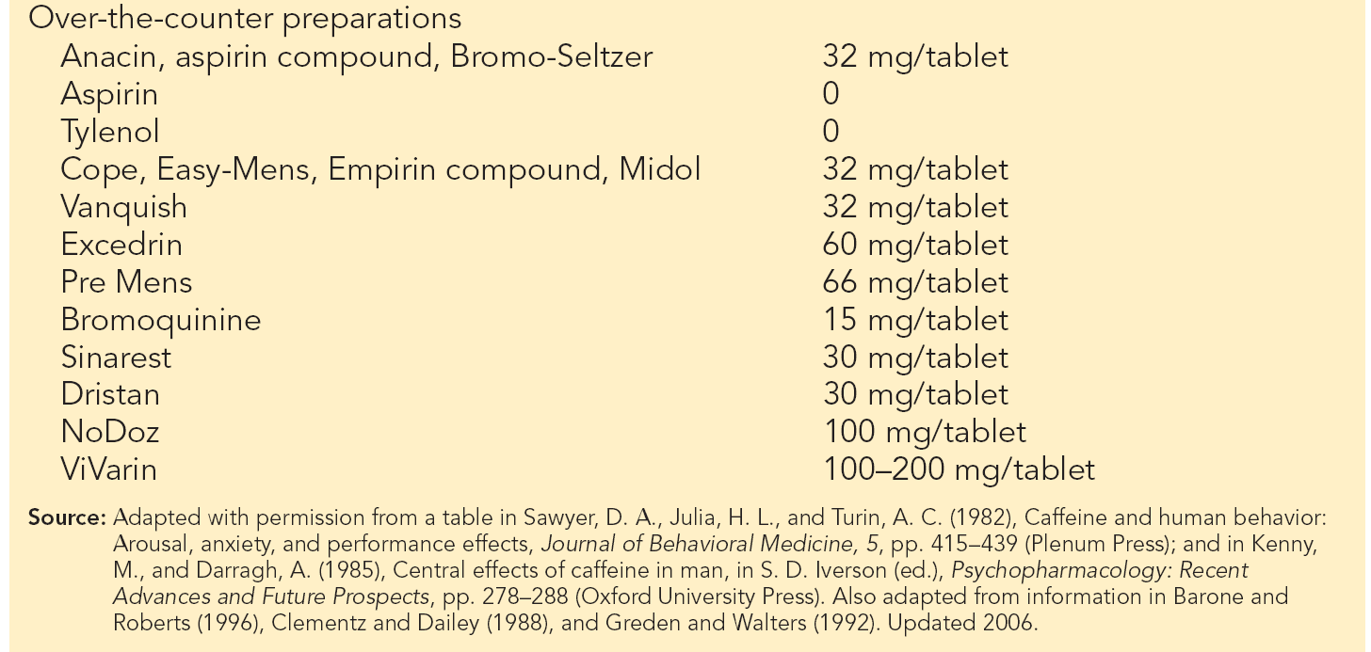

Slide 20
History of Caffeine Use
Coffee is believed to be discovered in Arabia
Legend has it, a holy man saw his goats jumping around at night instead of sleeping
He figured his goats were eating the beans from the coffee plants
He used the beans to help him through long nights of prayers
It is believed that in 2737 BC while Chinese Emperor, Shen Nung, was boiling water leaves from a nearby bush fell in the water making the first pot of tea
Europeans appeared to know nothing about caffeine substances until the 15th century
European explorers to Arabia, Ethiopia, and Turkey got introduced to coffee and brought it back to Europe

Slide 21
History of Caffeine Use - Continued
European explorers were introduced to Kola Nuts in West Africa
European explorers were introduced to cocoa in Mexico, Central and South America
Brazil is world’s largest producer of coffee
China, India, Sri Lanka, world’s largest producers of tea
West Africa is the world’s largest producer of cocoa
Adults 18 years plus are largest consumers of caffeine
Children 1-5 years are second largest consumers of caffeine

Slide 22
Pharmacology of Caffeine
Caffeine and other methylxanthines occupy and block adenosine receptor sites
Adenosine receptors are found in the central and peripheral nervous system
Caffeine is rapidly absorbed from the GI tract and distributed throughout the body
Caffeine’s ½ life is 2 ½ hrs to 7 ½ hrs. with peak effects 15-45 mins. after ingestion, depending on source
Caffeine is metabolized primarily in the liver & excreted mainly via the kidneys.

Slide 23
Pharmacology of Caffeine - Continued
Small amounts are excreted in stool, saliva, semen, and breast milk
Excretion rates are faster for long-term users and smokers
Liver disease, pregnancy and contraceptive use slows metabolism

Slide 24
Tolerance and Dependence
Evidence for caffeine withdrawal is distinct however for tolerance is not clear
Withdrawal symptoms include:
  Headaches-most common
  Depression & decreased alertness
  Sleepiness/drowsiness, decreased activity, decreased energy
  Less contentment/relaxed mood, increased irritability

Slide 25
Acute Effects of Caffeine
Acute effects of caffeine include: CNS, cardiac & gastric acid stimulation, diuresis, & relaxation of smooth muscles
Caffeine improves task performance by decreasing fatigue & increasing vigilance (motor component)
Caffeine impairs decision making however
Caffeine is often used with nicotine and alcohol. Nicotine causes it to be excreted 50% faster

Slide 26
Acute Toxic Effect of Caffeine - Continued
Caffeine intoxication is also known as caffeinism
Intoxication results from consuming 600mg/day to 1000 mg/day but intoxication can result from consuming 250 mg/day
Symptoms of caffeinism are:
  Muscle twitching, rambling thoughts & speech
  Arrhythmia and spells of exhaustibility
  Psychomotor agitation (increase in sensory motor reaction time)
  Ear ringing and light flashes

Slide 27
Acute Toxic Effect of Caffeine - Continued
Lethal dose of caffeine is 10 grams for adults or 100 mg/kg for children
(Equivalent of 75 cups of coffee, 125 cups of tea, 200 colas, 100 No Doz tabs)
  1 No Doz tab= 1 cup of coffee=100 mg caffeine
Caffeine is a relatively safe drug
Death from overdose is rare, more likely caffeine overexposure

Slide 28
Topical Analgesics
Counterirritants & Local Anesthetics:
  Analgesics: give relief by causing a systemic & topical analgesia;
      Inhibit pain sensations by rapid evaporation – causes cooling action, counterirritant of the skin,
      Causes local increase in blood circulation, redness, and rise in skin temp, superficial vasodialator
      Spray Coolants, Alcohol, Menthol, Cold, Local Anesthetics (lydocaine)
  Narcotic Analgesics: derived from opium, depresses pain impulses; depresses respiratory center
      Codeine, Darvon, Morphine, Demerol
  Non-narcotic analgesics & antipyretics: suppresses fever, pain
      Acetaminophen: has no anti-inflammatory activity, doesn’t irritate the stomach, over ingestion could lead to liver damage

Slide 29
Local Anesthetics
The potency of Local Anesthetics, their onset and duration of action are primary determined by physicochemical properties of various agents and their inherent vasodilator activity of same local anesthetics
Lipid solubility is the primary determinant of anesthetic potency
Protein binding influences the duration of action
The addition of vasoconstrictors, such as epinephrine or phenylephrine can prolong duration of action of local anesthetics and decrease their absorption

Slide 30
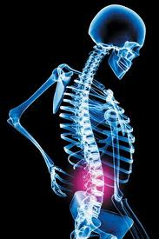
Uses of Local Anesthetics
Topical
Local infiltration
Minor peripheral nerve blockade
Major peripheral nerve blockade
Chronic pain

Slide 31
Role of the Athletic Trainer
Understand individual pain tolerance
Educate patient on NSAID use
Understand the differences in various NSAIDs
Do not use counterirritants on open wounds
Do not cover a counterirritant with an occlusive dressing

