Slide 1
Drugs for treating infections
Chapter 5

Slide 2
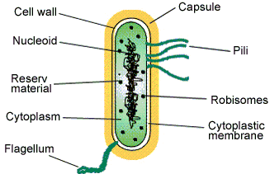
Microorganisms & Terminology
Bacteria
Found everywhere, in all possible habitats
These are basically unicellular but may live in association with other cells forming colonies
The bacterial cell is delineated by a rigid cell wall.
Bacteria is devoid of any nucleus, nucleolus or nuclear membrane
The DNA is mostly circular in nature and are not associated histone proteins
None of the membrane bound cell organelle are present like the golgi bodies, endoplasmic reticulum, mitochondria, or chloroplast
Cell Structure

Slide 3
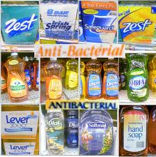
Microorganisms & Terminology
Antibiotic
A drug used to treat bacterial infections
Antibacterial
Treatment of bacterial infections
Viruses
They reproduce at a fantastic rate, but only in living host cells
They can mutate
They are acellular, that is, they contain no cytoplasm or cellular organelles.
They carry out no metabolism on their own and must replicate using the host cell's metabolic machinery.
The vast majority of viruses contain only one type of nucleic acid: DNA or RNA, but not both
They are totally dependent on a host cell for replication

Slide 4
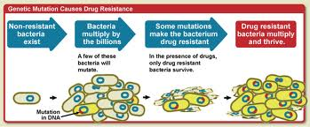
Antimicrobial Resistance
Drug Resistance
Develops because of a change in the genetic make-up of microorganisms
Factors leading to drug resistance:
Excessive use of antibiotics and antimalarials
Insufficient control on drug prescribing
Inadequate compliance with treatment regimens
Prescribing inappropriate doses
Lack of infection control
Increasing frequency and speed of travel

Slide 5
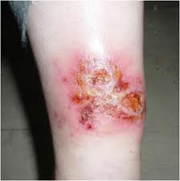
Superinfections
The process by which a cell, that has previously been infected by one virus, gets coinfected with a different strain of the virus, or another virus at a later point in time
Viral superinfections of serious conditions can lead to resistant strains of the virus, which may prompt a change of treatment
May follow a previous infection, especially when caused by microorganisms that are resistant or have become resistant to the antibiotics used earlier
A condition produced by sudden growth of a type of bacteria, different from the original offenders in a wound or lesion under treatment
Superinfection with streptococcus

Slide 6
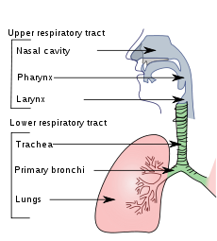
Respiratory Infections
Upper Respiratory Infection
Caused by an acute infection which involves the upper respiratory tract: nose, sinuses, pharynx or larynx
Acute upper respiratory tract infections include rhinitis, pharyngitis/tonsillitis and laryngitis often referred to as a common cold, and their
complications: sinusitis, ear infection and sometimes bronchitis
Symptoms of URI's commonly include cough, sore throat, runny nose, nasal congestion, headache, low grade fever, facial pressure and sneezing
Onset of symptoms usually begins 1–3 days after exposure
The illness usually lasts 7–10 days

Slide 7
Respiratory Infections
Lower Respiratory Infection
The lower respiratory tract is the part of the respiratory tract below the vocal cords
Lower respiratory tract infection, or pneumonia, can also be applied to other types of infection including lung abscess and acute bronchitis
Symptoms include shortness of breath, weakness, high fever, coughing and fatigue

Slide 8
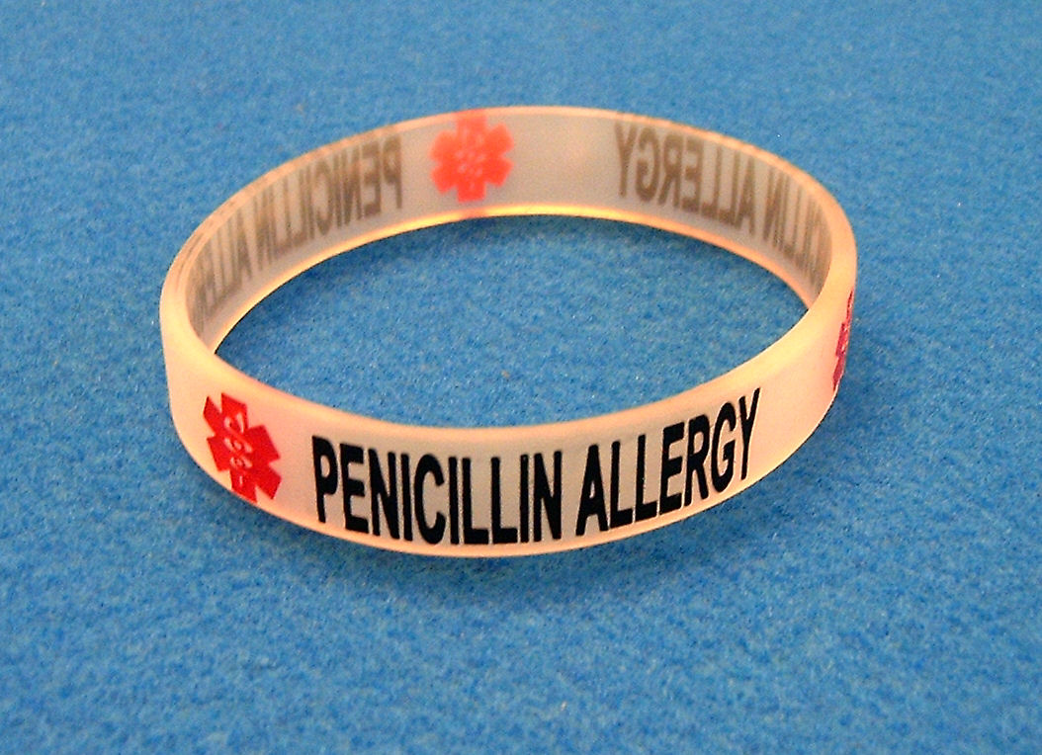
Antibacterial Drugs
Penicillins
Inhibits cell wall synthesis
Bacterialcidal
10% of patients allergic to penicillin
Primary use
Urinary tract, respiratory tract, heart, syphilis
Excreted through urine

Slide 9
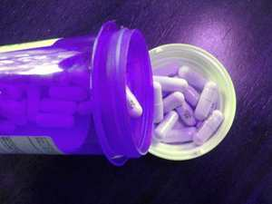
Antibacterial Drugs
Caphalosporins
Inhibits cell synthesis
Bactericidal
Can cause an allergic reaction
Primary use
Respiratory tract, urinary tract, bacteremia, skin, soft tissue infections
Excreted through urine

Slide 10
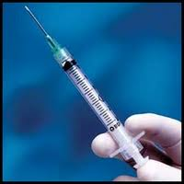
Antibacterial Drugs
Carbapenems
Inhibits cell synthesis
Bactericidal
Can cause an allergic reaction
Primary use
Skin, urinary tract, pneumonia, pelvic infections
Excreted through urine

Slide 11
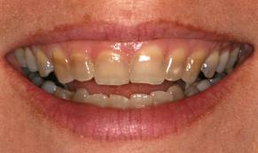
Antibacterial Drugs
Tetracyclines
Inhibits cell synthesis
Bacteriostatc
Adverse Effects
Epigastric burning, nausea, vomiting, diarrhea, photosensitivity, bones & teeth in patients < 8
Primary use
Rocky Mountain fever, cholera, Lyme disease, pneumonia
Excreted through urine & bile
Do not take with food
Tetracycline Sensitivity

Slide 12
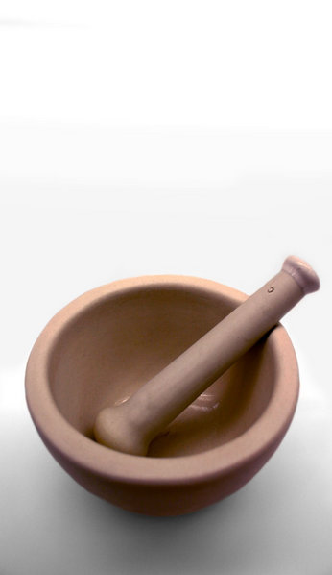
Antibacterial Drugs
Macrolides
Inhibits cell synthesis
Bacteriostatic
Adverse Effects
Epigastric burning, & nausea
Primary use
Infections of the GI, genitals, & respiratory tracts, skin, & soft tissue infection
Excreted through urine & bile

Slide 13
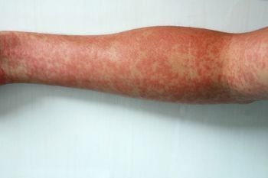
Antibacterial Drugs
Sulfonamides
Inhibits an enzyme needed for bacterial proliferation
Bacteriostatic
Adverse Effects
Crystallization in urine if not enough water consumed, skin rash, photosensitivity
Primary use
Urinary tract infections, pneumonia, upper respiratory infections, eye infections, 2nd & 3rd degree burns
Excreted through urine
Sulfonamides Allergic Reaction

Slide 14
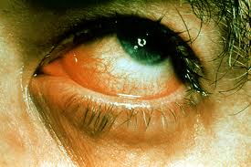
Antibacterial Drugs
Aminoglycosides
Inhibits protein synthesis
Bactericidal
Adverse Effects
Ototoxicity – damage to ear, nephrotoxicity – damage to kidneys
Primary use
Urinary tract infections, respiratory infections, eyes, ears, skin
Excreted through urine
Bacteria in Eye

Slide 15
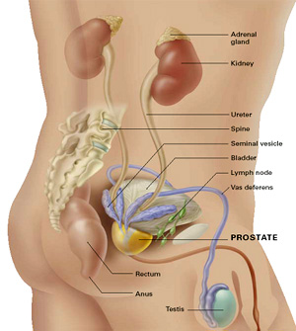
Antibacterial Drugs
Fluoroquinolones
Inhibits DNA synthesis
Bactericidal
Adverse Effects
Nausea, vomiting, headaches, dizziness, phototoxicity, potential tendon rupture, cartilage lesions
Primary use
Urinary tract infections, respiratory infections, prostate, GI tract, bones, joints, soft tissue
Excreted through urine & GI tract
Do not take with food, drugs, and mineral supplements

Slide 16
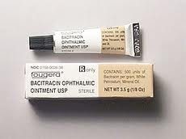
Topical Antibacterial Drugs
Bacitracin
Does not work well orally
Very effective topically, and is a common ingredient of eye and skin antibiotic preparations
Can cause contact dermatitis and cross-reacts with allergic sensitivity to sulfa-drugs.
When given intramuscularly, bacitracin's absorption is rapid and complete

Slide 17
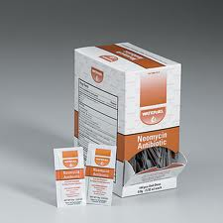
Topical Antibacterial Drugs
Neomycin
Used as a topical preparation such as Neosporin
It can also be given orally, where it is usually combined with other antibiotics
Neomycin is not absorbed from the gastrointestinal tract and has been used as a preventive measure for killing bacteria in the intestinal tract
Keeps ammonia levels low
Used to treat small intestinal bacterial overgrowth

Slide 18
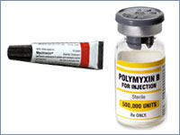
Topical Antibacterial Drugs
Polymyxin B
Polymyxins bind to the cell membrane and alter its structure, making it more permeable
The resulting water uptake leads to cell death
Side-effects include neurotoxicity and acute renal tubular necrosis
Commonly used in the topical first-aid preparation Neosporin

Slide 19
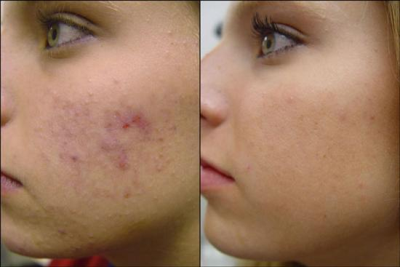
Topical Antibacterial Drugs
Tetracycline
Indicated for use against many bacterial infections
It is a protein synthesis inhibitor
Commonly used to treat acne
Historically important in reducing the number of deaths from cholera
Marketed under the brand names Sumycin, Terramycin, Tetracyn, and Panmycin
Before & After

Slide 20
Topical Antifungal
Lotrimin/Clotrimazole
Cream, Lotion, solution, powder
Used to treat yeast infections of the vagina, mouth, and skin such as athlete's foot, jock itch, and body ringworm. It c
Can also be used to prevent oral thrush in certain patients
Side Effects
Itching
Burning
Irritation
Redness
Swelling
Stomach pain
Fever
Foul-smelling discharge if using the vaginal product
Upset stomach or vomiting with the lozenges

Slide 21
Topical Antifungal
Micatin/Monistat
Used for skin infections such as athlete's foot and jock itch and for vaginal yeast infections
Cream, lotion, powder, spray liquid, and spray powder to be applied to the skin
Also comes as a cream and suppository to be inserted into the vagina
Side Effects
Increased burning, itching, or irritation of the skin or vagina
Stomach pain
Fever
Foul-smelling vaginal discharge

Slide 22
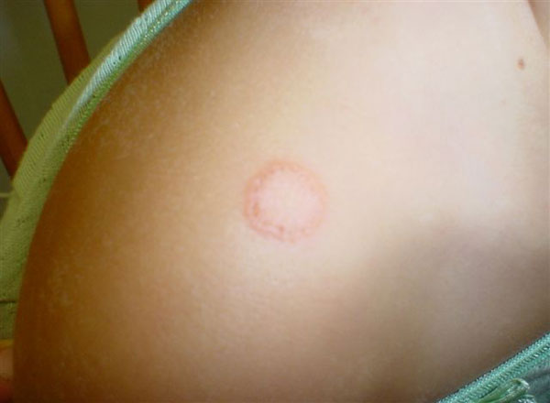
Topical Antifungal
Tinactin/Tolnaftate
Stops the growth of fungi that cause skin infections
Athlete's foot, Jock itch, Ringworm
Comes as a cream, liquid, powder, gel, spray powder, and spray liquid for application to the skin
Burning and soreness of athlete's foot or the itching of jock itch should decrease within 2 to 3 days
Continue treatment for at least 2 weeks after symptoms disappear
Side Effect
Skin Irritation
Ring worm

Slide 23
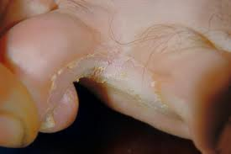
Topical Antifungal
Desenex/Undeclenic Acid
Used for skin infections such as athlete's foot and jock itch and for vaginal yeast infections
Cream, lotion, powder, spray liquid, and spray powder
Side Effects
Side Effects
Increased burning, itching, or irritation of the skin or vagina
Stomach pain
Fever
Foul-smelling vaginal discharge
Athlete’s Foot

Slide 24
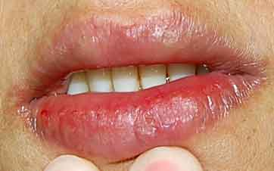
OTC Antiseptics
Campho-Phenique
Gel, Liquid
A skin proctant
Camphor and phenol are mild topical (for the skin) pain relievers
Used to treat pain, itching, or severe lip dryness caused by chapped lips or cold sores (fever blisters).
This medication will not cure herpes simplex, a virus that causes cold sores
Side Effects if allergic: hives; difficulty breathing; swelling of your face, lips, tongue, or throat
Dry Lips

Slide 25
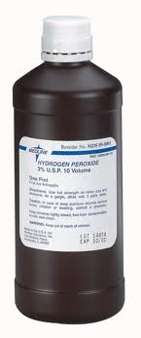
OTC Antiseptics
Hydrogen Peroxide
Solution, towelettes
3% solution used as antiseptic
Disinfectant
Antiseptic
Destroys newly formed skin
Can lead to scarring

Slide 26
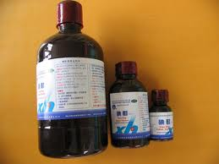
OTC Antiseptics
Iodine Tincture
Tincture (alcohol extract)
Topical antibacterial
Used for minor abrasions, burns, or cuts
Contraindications: Pregnancy, breast feeding, pediatrics, labor & delivary

Slide 27
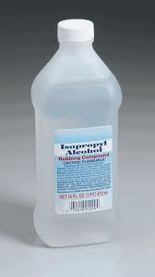
OTC Antiseptics
Isopropyl Alcohol
Disinfectant
Poisoning can occur from ingestion, inhalation, or absorption
Symptoms of poisoning: flushing, headache, dizziness, CNS depression, nausea, vomiting, anesthesia, and coma

Slide 28
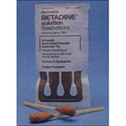
OTC Antiseptics
Betadine
Aerosol, cream, gel, ointment, shampoo
Treating minor wounds and infections, as well as killing bacteria
Contraindications:
Pregnant, planning to become pregnant, or are breast-feeding
If you are taking any prescription or nonprescription medicine, herbal preparation, or dietary supplement
If you have serious burns or deep puncture wounds

Slide 29
Role of the Athletic Trainer
Educate the patient regarding infections
Discuss compliancy with the patient
Monitor for allergies
Monitor for adverse effects
Monitor for effectiveness

Slide 30
Drugs for treating inflammation
Chapter 6

Slide 31
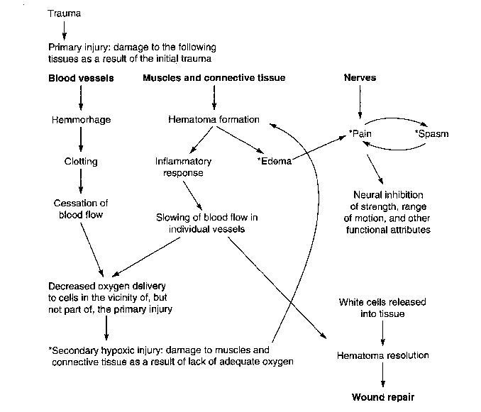
Inflammation Process

Slide 32
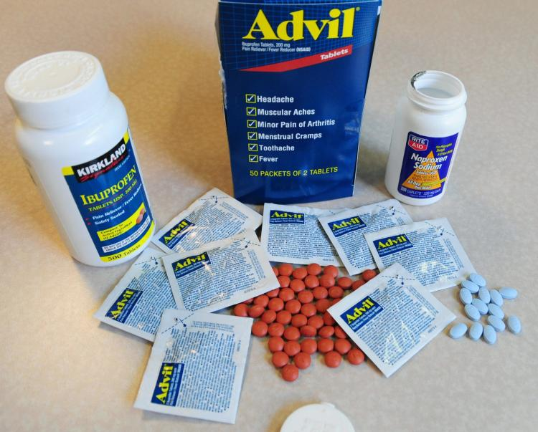
Nonsteroidal Anti-Inflammatory Drugs
NSAIDs
Most frequently prescribed drugs & frequently used OTC drugs
Pain relievers
Reduce inflammation and lower fevers, prevent blood from clotting
Contraindications: pregnant, have high blood pressure, asthma, or a history of kidney or liver disease, or have had ulcers in the past, people older than 65 years of age
NSAIDs may intensify or counteract the effects of some medications
NSAIDs work by preventing an enzyme (a protein that triggers changes in the body) from doing its job

Slide 33
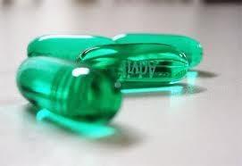
Nonsteroidal Anti-Inflammatory Drugs
Advil/Ibuprofen
Nonprescription ibuprofen is used to reduce fever and to relieve mild pain from headaches, muscle aches, arthritis, menstrual periods, the common cold, toothaches, and backaches
Contraindications: ibuprofen allergy, some medications, vitamins, nutritional supplements, & herbal products, asthma, pregnancy, or pending surgery
Side Effects: constipation, diarrhea, gas or bloating, dizziness, nervousness, ringing in the ears, unexplained weight gain, fever, blisters, rash, itching, hives, swelling of the eyes, face, throat, arms, hands, feet, ankles, or lower legs, difficulty breathing or swallowing, hoarseness, excessive tiredness, pain in the upper right part of the stomach, nausea, loss of appetite, yellowing of the skin or eyes, flu-like symptoms, pale skin, fast heartbeat, cloudy, discolored, or bloody urine, back pain, difficult or painful urination, blurred vision, changes in color vision, or other vision problems, red or painful eyes, stiff neck, headache, confusion, aggression

Slide 34
Nonsteroidal Anti-Inflammatory Drugs
Aleve/Naproxen Na
Indications: used to relieve pain, tenderness, swelling, and stiffness caused by osteoarthritis (arthritis caused by a breakdown of the lining of the joints), rheumatoid arthritis (arthritis caused by swelling of the lining of the joints), juvenile arthritis (a form of joint disease in children), and ankylosing spondylitis (arthritis that mainly affects the spine). Prescription naproxen tablets, extended-release tablets, and suspension are also used to relieve shoulder pain caused by bursitis (inflammation of a fluid-filled sac in the shoulder joint), tendinitis (inflammation of the tissue that connects muscle to bone), gouty arthritis (attacks of joint pain caused by a build-up of certain substances in the joints), and pain from other causes, including menstrual pain (pain that happens before or during a menstrual period). Nonprescription naproxen is used to reduce fever and to relieve mild pain from headaches, muscle aches, arthritis, menstrual periods, the common cold, toothaches, and backaches
Contraindications: ibuprofen allergy, some medications, vitamins, nutritional supplements, & herbal products, asthma, pregnancy, or pending surgery
Side Effects: constipation, diarrhea, gas, sores in mouth, excessive thirst, headache, dizziness, ightheadedness, drowsiness, difficulty falling asleep or staying asleep, burning or tingling in the arms or legs, cold symptoms, ringing in the ears, hearing problems, changes in vision, feeling that the tablet is stuck in your throat, unexplained weight gain, sore throat, fever, chills, and other signs of infection, blisters, rash, skin reddening, itching, hives, swelling of the eyes, face, lips, tongue, throat, arms, hands, feet, ankles, or lower legs, difficulty breathing or swallowing, hoarseness, excessive tiredness, pain in the upper right part of the stomach, nausea, loss of appetite, yellowing of the skin or eyes, flu-like symptoms, bruises or purple blotches under the skin, pale skin, fast heartbeat, cloudy, discolored, or bloody urine, back pain, difficult or painful urination

Slide 35
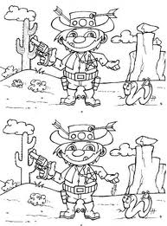
Differences between advil & Aleve
The active ingredient in Advil is ibuprofen
Each Advil tablet contains 200 mg of ibuprofen
Aleve tablets contain 220 mg naproxen sodium
Advil: Adults and children 12 years old and over should take one tablet every 4 to 6 hours while symptoms persist
Aleve: Take one Aleve every 8 to 12 hours while symptoms last
Essentially, the effects of Advil last for 4 to 8 hours while Aleve lasts for 8 to 12 hours.
Find 7 Differences

Slide 36
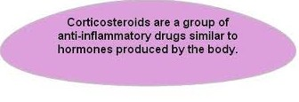
Corticosteroids
Corticosteroids are drugs closely related to cortisol, a hormone which is naturally produced in the adrenal cortex (the outer layer of the adrenal gland)
Corticosteroids act on the immune system by blocking the production of substances that trigger allergic and inflammatory actions, such as prostaglandins
They also impede the function of white blood cells which destroy foreign bodies and help keep the immune system functioning properly

Slide 37
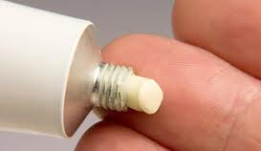
Corticosteroids
Corticosteroid drugs can also be used as ingredients contained in:
Eye products (to treat various eye conditions)
Inhalers (to treat asthma or bronchial disease)
Nasal drops and sprays (to treat various nasal problems)
Topical creams, ointments, etc. (to treat various skin problems)

Slide 38
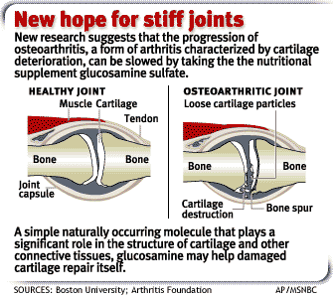
Glucosamine
Anti-inflammatory for osteoarthritis
Inhibiting the synthesis of substances that contribute to the damage of cartilage
Glucosamine is thought to stimulate synovial production of hyaluronic acid, which is important for plasma membrane production, and is also claimed to inhibit cartilage degrading liposomal enzymes
Minimal side effects: GI, headaches, rash

Slide 39
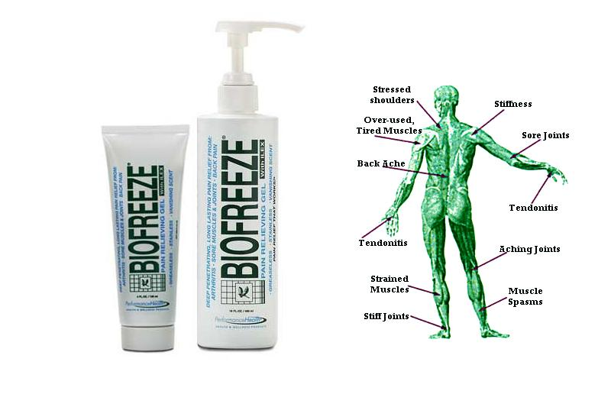
Topical anti-inflammatory products
Aspercreme
Temporarily relieving minor pain and inflammation
Topical salicylate pain reliever
Reduces swelling and inflammation in the muscle and joints
Ben-Gay
Methyl salicylate, menthol and camphor are external analgesics which stimulate sensory receptors of warmth and/or cold
Produces a counter-irritant response which provides temporary relief of minor aches and pains of muscles and joints associated, arthritis, strains and sprains
Salicylate or Counter-irritant

Slide 40
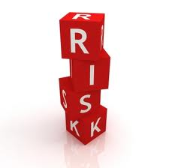
Role of the Athletic Trainer & Anti-inflammatories
Understand the benefits & risks
NSAIDs taken with food
One dose at a time

