Slide 1
Pharmacodynamic Principles
Chapter 3

Slide 2
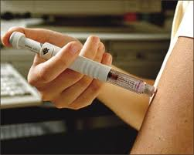
Pharmacodynamic Principles
Pharmacodynamics
Definition: The study of the impact of drugs on the body
  Primary focus are the mechanisms by which drugs exert their therapeutic & adverse effects
  As the dose changes the type and degree of the response changes
  More receptors will be occupied

Slide 3
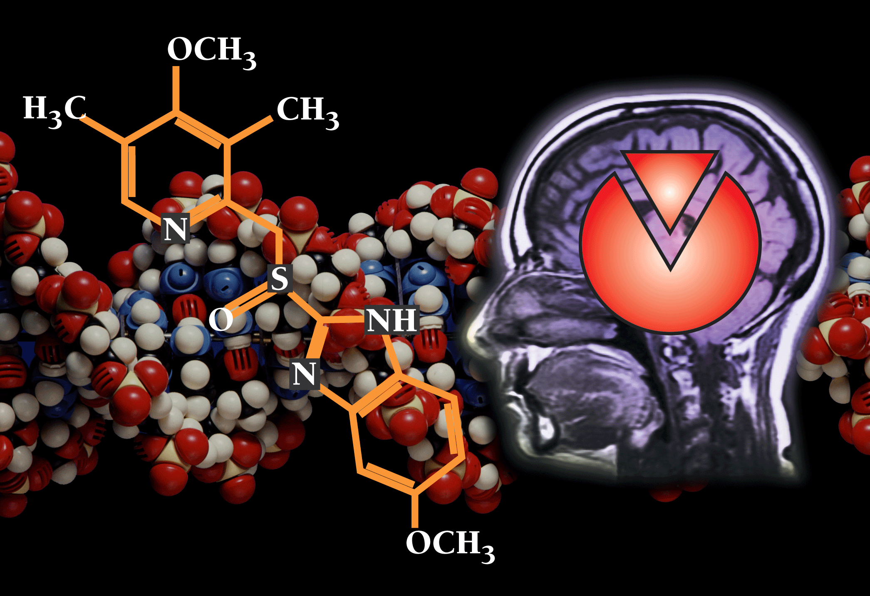
Pharmacodynamic Principles
Pharmacodynamics
Therapeutics
  The study of the parameters that determine the most appropriate therapy for the patient

Slide 4
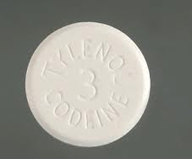
Pharmacodynamic Principles
Foundational Concepts
Is codeine dispense in the SM Clinic?
Addictive Effect
  An effect in which two substances or actions used in combination produce a total effect the same as the sum of the individual effects
Synergistic Effect
  The use of two or more drugs that produce a greater effect of one drug used alone
  Ex. NSAID added to codeine for pain relief

Slide 5
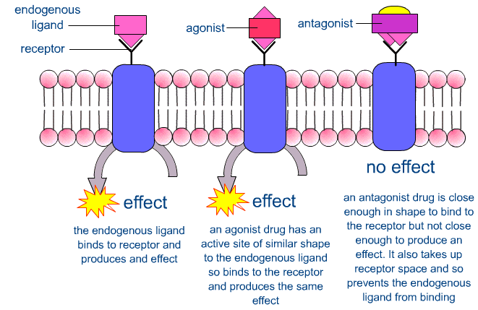
Pharmacodynamic Principles
Foundational concepts
Antagonistic Effect
  The use of a second drug reduces the effect of another drug
  The second drug has an antagonistic effect
  A second drug may bind to the same receptor as the first drug, thus preventing the agonist response

Slide 6
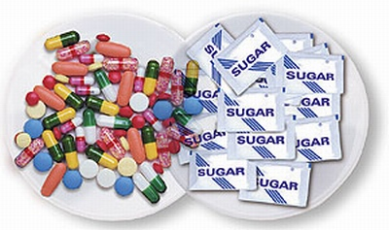
Pharmacodynamic Principles
Foundational concepts
Is the placebo effect an ethical patient treatment in AT?
Placebo Effect
  Either a therapeutic or adverse response that cannot be attributed to the pharmacological effect of the drug
  Contains no active ingredient
  35% of the population responds to a placebo effect
    Responses include relief of fever, headache, anxiety, nausea, & pain
    Effect is not imaginary

Slide 7
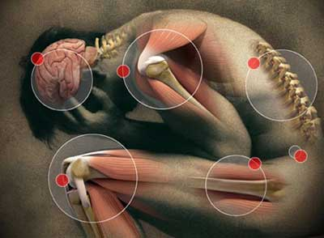
Pharmacodynamic Principles
Foundational concepts
Can a placebo be used as a diabetic treatment?
If a patient is convinced that pain relief is imminent upon administration of an analgesic, a placebo effect may bring greater relief than what would be expected from the drug alone

Slide 8
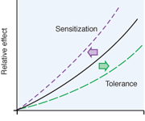
Pharmacodynamic Principles
Foundational concepts
Tolerance
  A diminished response to a drug as a result of continued use
  Not all drugs produce tolerance
  When tolerance is developed for one drug in a category, a cross tolerance may developed for another drug in the same category

Slide 9
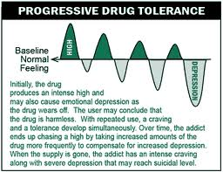
Pharmacodynamic Principles
Foundational concepts
Enzyme or receptor?
2 major mechanisms that cause pharmacological tolerance
  Enzyme Induction
    The liver produces more drug-metabolizing enzymes
  Receptor Effects
    Responsiveness of the receptors decreased

Slide 10
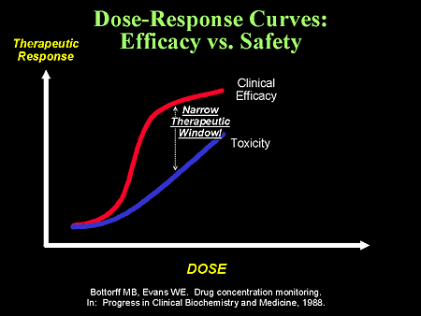
Pharmacodynamic Principles
Dose-response relationship
As the concentration of the drug increases, more molecules will occupy more receptors, which then produces a greater response
This is known as the Does-Response Principle

Slide 11
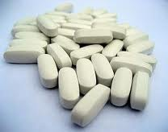
Pharmacodynamic Principles
Single dose
Caffeine or amphetamines?
Potency
  The dose of a drug required to produce a particular effect relative to the dose of another drug that acts by a similar mechanism to produce the same effect
  Caffeine vs Amphetamines

Slide 12
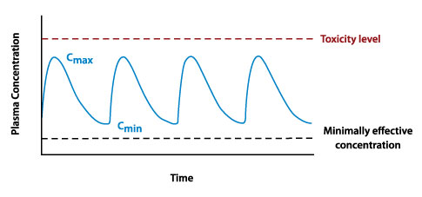
Pharmacodynamic Principles
Multiple dose & Steady State
When multiple doses of a drug are administered, blood concentration increases beyond that of a single dose
The body absorbs what it can and metabolizes or excretes the excess
The “leveling off” of the drug is the steady state

Slide 13
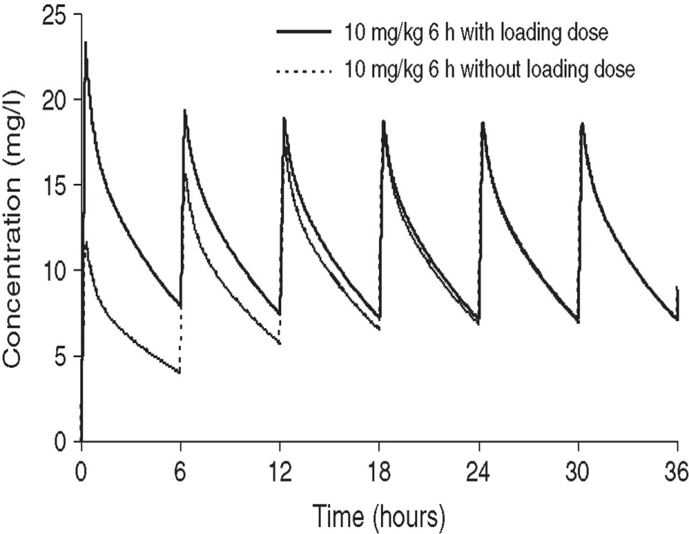
Pharmacodynamic Principles
Maintenance & loading
Maintenance Dose
  A dose administered at a regular dosing interval on a repetitive basis
Loading Dose
  One or more doses that are higher than the maintenance dose & administered at the beginning of therapy
  Achieves the desirable concentration quicker

Slide 14
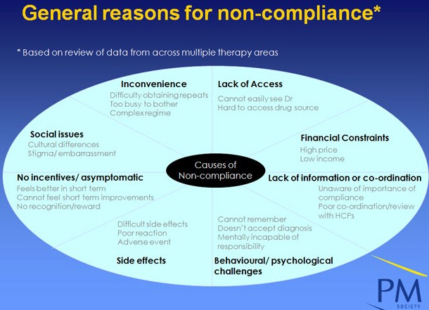
Pharmacodynamic Principles
Patient compliance
Refers to the extent to which the patient is taking the medication as prescribed
Reasons for patient non-compliance
  High cost
  Forgetting to take meds
  Inconvenience
  Poor patient education

Slide 15
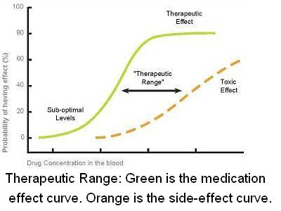
Pharmacodynamic Principles
Therapeutic drug monitoring
Measure blood concentration of the drug
The range between the low and high desired concentration is referred to as therapeutic range or therapeutic window

Slide 16
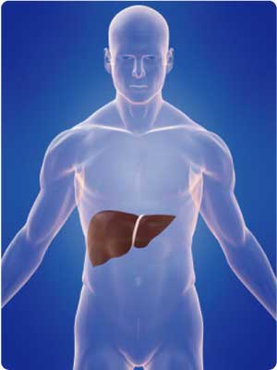
Pharmacodynamic Principles
Liver & kidney function
Human liver
The liver and kidney remove most drugs from the body
Disease, drug toxicity, & aging process may necessitate dosage adjustment

Slide 17
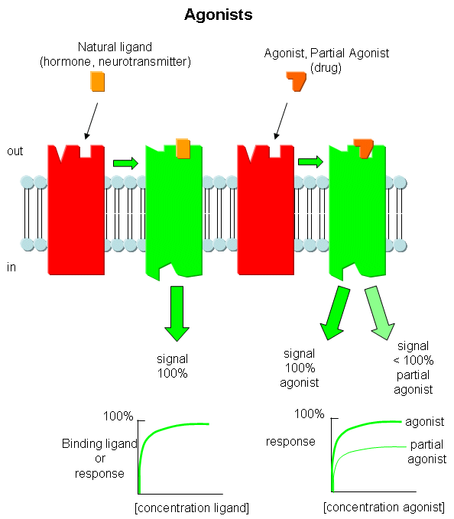
Pharmacodynamic Principles
Types of drug interactions
Receptor Antagonist
  2 drugs have an affinity for the same receptor
  One drug displaces the other and diminishes the response
  Agonist vs Antogonist

Slide 18
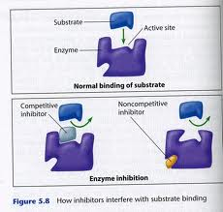
Pharmacodynamic Principles
Types of drug interaction
Enzyme Induction
  When a drug increases the metabolizing enzymes for another drug
Enzyme Inhibition
  2 drugs bind on the same metabolizing enzyme
  One drug inhibits the enzyme for the other

Slide 19
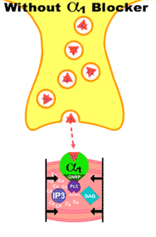
Pharmacodynamic Principles
Types of drug interactions
Physiologic Antagonism
  2 drugs given concurrently oppose each other
  Neither drug effects the mechanism of action

Slide 20
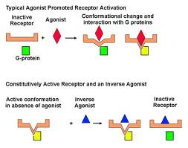
Pharmacodynamic Principles
Types of drug interactions
Physiologic Agonists
  2 or more drugs used concurrently result in an increase in physiologic effects
  The drugs do not have the same mechanism of action

Slide 21

Pharmacodynamic Principles
Types of drug interactions
Absorption Effects
  The use of one drug inhibits the absorption of another when given concurrently
Excretion Effects
  One drug increases or decreases the excretion of another

Slide 22
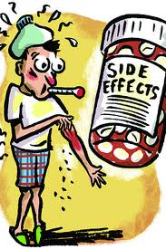
Pharmacodynamic Principles
Adverse drug reactions
Side Effects
  Expected responses based on the pharmacologic action of the drug
Allergic Reactions
  Exaggerated immune response to a certain drug
Organ Cytotoxic Effects
  Adverse effects on organs

Slide 23
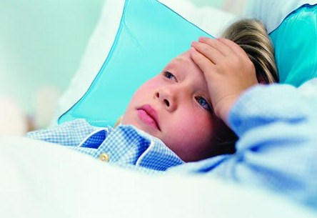
Pharmacodynamic Principles
Adverse drug reactions
Idiosyncratic Reactions
  Reaction that is particular to an individual or defined group of people
Drug-drug Interactions
  Interaction of 2 or more drugs that result in a disadvantage to a patient
Drug-food Interactions
  Interaction of a drug with food that results in an adverse patient reaction

Slide 24
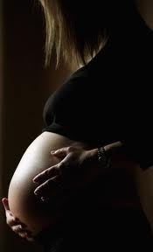
Pharmacodynamic Principles
Adverse drug reactions
Drug-herb Interactions
  Interaction of a drug with herbal products that results in an adverse patient reaction
Drug Use During Pregnancy
  Most drugs cross the placenta
  Thus, posing an adverse reaction to the child

Slide 25
Medication management in athletic training facilities
Chapter 4

Slide 26
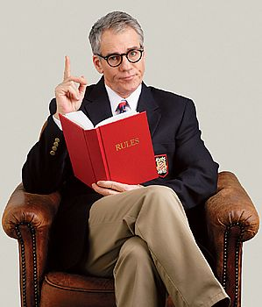
Medication Management
State vs Federal
If a state & federal laws are in conflict, follow the stricter code of the two

Slide 27
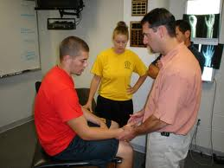
Medication Management
Head Team physician
Anytime medications are stored in an athletic training facility, there must be a license physician who accepts responsibility for the medication

Slide 28
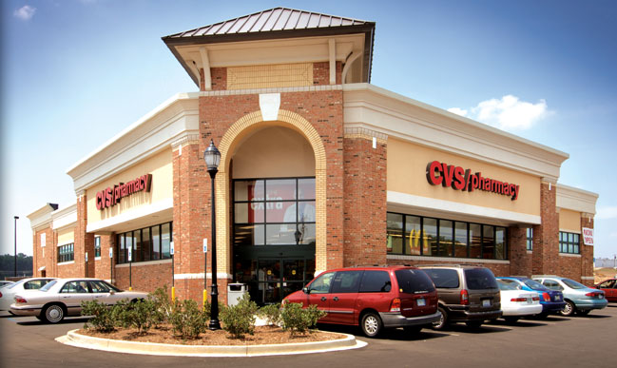
Medication Management
Team pharmacy
In a best-practice situation, each athletic training facility should have a designated team pharmacy
The team pharmacy is required to be licensed by the state & DEA
The athletic trainer should maintain a copy of the team pharmacy license

Slide 29
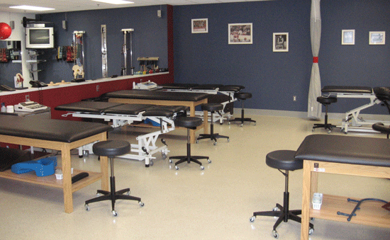
Medication Management
Dose
Administered Dose
  Medication given to a patient that is taken within 24 hours
Dispensed Dose
  An amount of medication to be consumed by the patient in a period >24 hours
Treatment
  Medication given within the athletic training facility

Slide 30

Medication Management
Authorization
Patient
  Illegal for anyone to pick up a medication for someone other than an immediate family member or without permission in writing
Unsecured Medication
  Federal law states that all medications are to be locked & secured

Slide 31
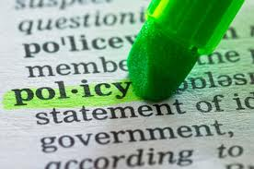
Medication Management
Policies & Procedures
A policy & procedure manual in regards to medications should be kept on file in the facility

Slide 32
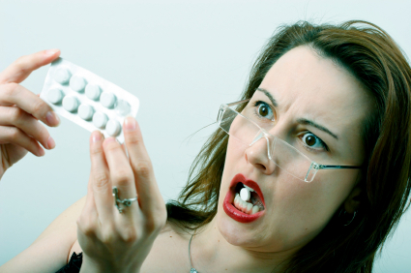
Medication Management
Expired Medications
There is no justification for expired medication to be stored or dispensed in a facility

Slide 33

Medication Management
Security
State & Federal law require all medications to be locked and secured cabinet or container
If medications are stored in a refrigerator, the refrigerator must be locked

Slide 34
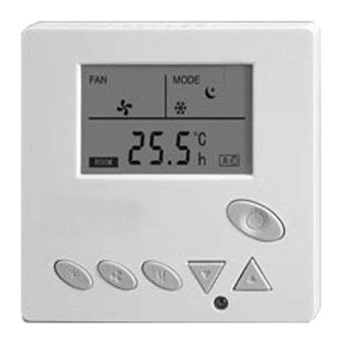
Medication Management
Storage
Most medications must be stored at room temperature

Slide 35
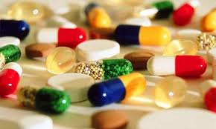
Medication Management
TrAVELING WITH MEDICATIONS
Medications that have not been dispensed and labeled must be transported by a licensed individual

Slide 36

Medication Management
International Travel
Follow the policy & procedure manual of the facility
Follow international law

Slide 37

Medication Management
Audit & Reconciliation
Medications must be audited & reconciled every year

Slide 38
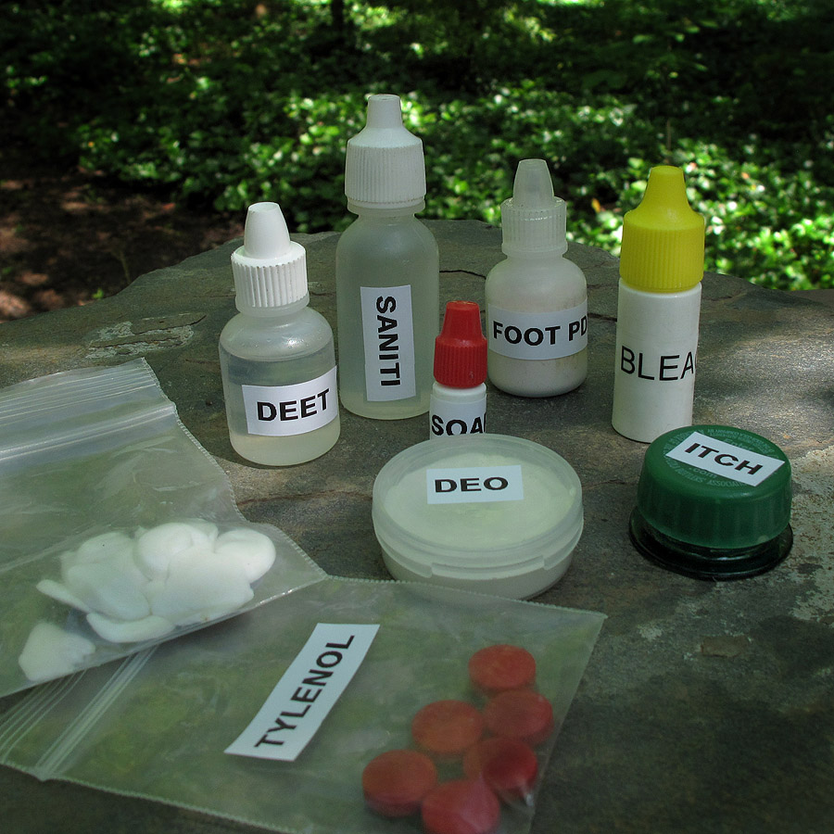
Medication Management
Repackaging Prescription & OTC Medications
Taking bulk OTC meds & placing them into smaller plastic bottles for transporting or repackaging is a violation of the law

