Slide 1
Chapter 1
Introduction to Pharmacology

Slide 2
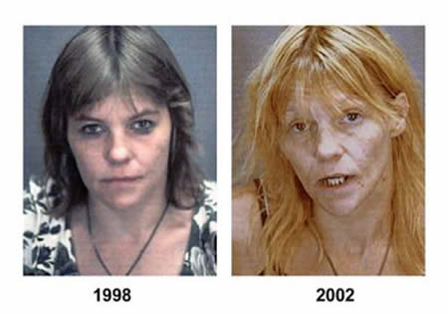
Introduction to Pharmacology
Foundational Concepts
Pharmacology: The effect of drugs on a body and the effect of the body on drugs.

Slide 3
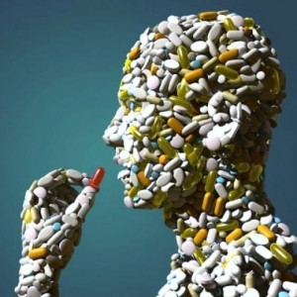
Introduction to Pharmacology
Foundational Concepts
Drugs interact with the cells and extracellular components on a molecular level to produce an effect.
Molecular interactions between the drug and body determine how, when, and where the action of the drug will be terminated.
Pharmacology encompasses the therapeutic responses and adverse effects of drugs as well as the absorption, metabolism, and excretion of drugs.

Slide 4
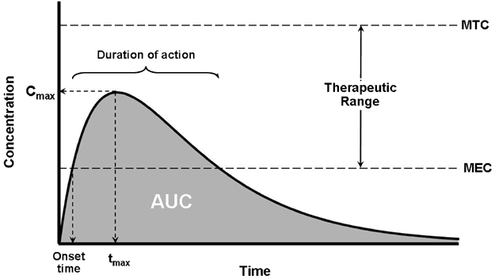
Introduction to Pharmacology
Subdivisions of Pharmacology
Pharmacokinetics: Factors that affect the time course of the drug.
  Rate at which drugs begin to take effect
  Duration of the effect
  Rate of change at the of action

Slide 5
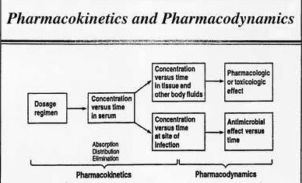
Introduction to Pharmacology
Subdivision of pharmacology
Pharmacodynamics: The study of the mechanism of action of drugs.
  Combine with enzymes
  Combine with receptors

Slide 6
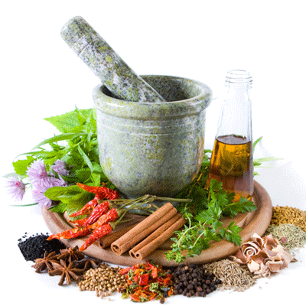
Introduction to Pharmacology
What is a drug
Chemicals used to treat or prevent disease
  Table sugar?
  Vitamins?
  Herbal products?

Slide 7
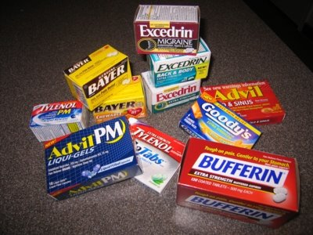
Introduction to Pharmacology
Classification of drugs
Grouped based on their chemistry
Categorized by legal classification
  OTC Drugs – drugs that do not require a prescription
  Prescription
  Controlled substances

Slide 8
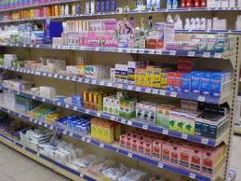
Introduction to Pharmacology
Classification of drugs-OTC
Do not require a prescription
Contain a lower of drug per dosage as compared to prescription drug
Contain multiple active ingredients in the same dosage form

Slide 9
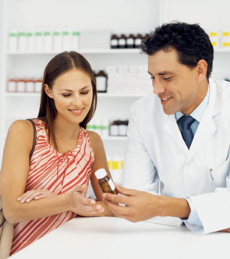
Introduction to Pharmacology
Classification of drugs-Prescription
Greater potential for adverse effects
Require monitoring for interaction with other drugs
Only used for a restricted time period
Medical supervision mandated
Prescribed by physician – prescription filled by pharmacist

Slide 10
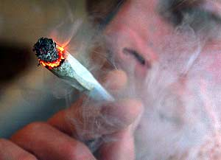
Introduction to Pharmacology
Classification of drugs-Controlled substances
What schedule drug is this?
Referred to as scheduled drugs
Have abuse potential
More restrictive requirements: distribution, storage, and record keeping as compared with prescription drugs
Schedule I have greatest potential for abuse – Schedule V have lowest potential for abuse

Slide 11
Chapter 2
Pharmacokinetic Principles

Slide 12
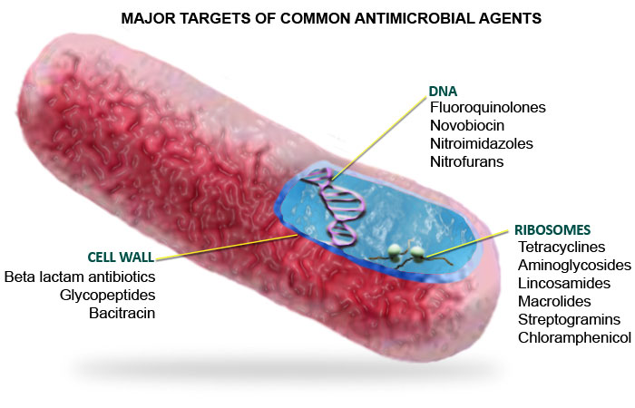
Pharmacokinetic Principles
Site of action
A drug must reach its site of action to have an effect
Intended site is called the molecular site
Molecular site is where a significant chemical reaction to produce a biologic affect takes place
Site of action is either a receptor on a cell surface or inside a specific cell or enzyme within a cell

Slide 13
Pharmacokinetic Principles
Onset and duration of action
Can we determine duration of action time?
Onset Action: the time it takes to cause a noticeable biological response from the drug taken
Duration Action: The length of time the drug produces an effect

Slide 14
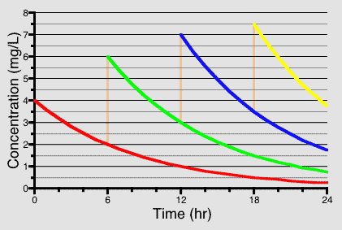
Pharmacokinetic Principles
Half-life & clearance rate
How long does it take blue to reach a half-life?
Half-life: the time required for the amount of drug in the blood to be reduced to one-half
Metabolism & excretion are the mechanisms that clear the drug from the body
Clearance Rate: a measurement of the time it takes for metabolism & excretion to be completed

Slide 15
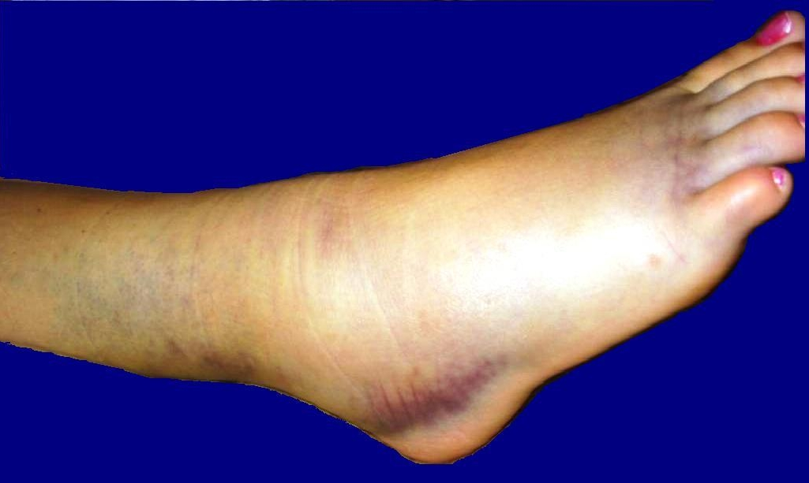
Pharmacokinetic Principles
Half-life
Naproxen or Ibuprofen?
Drugs with a longer half-life have a longer duration of action
Naproxen, a nonsteroidal anti-inflammatory drug (NSAID) has a half-life of 14 hours and is recommended to take twice per day. Ibuprofen has a half-life of 2 hours and is recommended to be taken 3 or 4 times per day.
Acutely sprained ankle…..

Slide 16
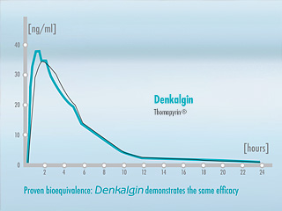
Pharmacokinetic Principles
Bioavailability& Bioequivalence
Do these drugs have bioequivalence?
Bioavailability: amount of drug available in systemic circulation (blood)
  Reduced if capsule incompletely dissolves in GI tract or drug is inactivated by intestinal enzymes
Bioequivalence: the amount and rate of drug entering the general circulation for 2 or more similar formulations of the same drug

Slide 17
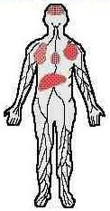
Pharmacokinetic Principles
Volume of distribution
Low or high volume of distribution?
V of D: the space in the body that is available to the drug
  The more extensive the distribution, the larger the volume of distribution
  Larger volume of distribution drugs: distribute into adipose tissue, bind to muscle, or bind to plasma protein
  Body size effects V of D, binding of drug to plasma increases V of D
Drugs with a high V of D have less drug available for blood circulation, thus less drug is available for the site of action

Slide 18
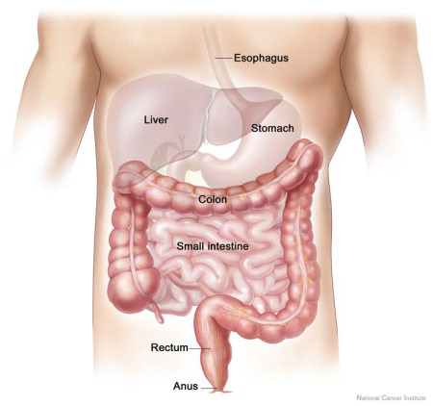
Pharmacokinetic Principles
Solubility of drugs
GI tract
Determines how quickly a drug is dissolved in the GI tract
More water soluble the drug, the more readily it will dissolve in the GI Tract
More lipid soluble the drug, the more readily the drug will cross membranes to move form the GI tract into the blood
Water soluble drugs excreted by the kidneys faster
Lipid soluble penetrate the CNS more readily

Slide 19
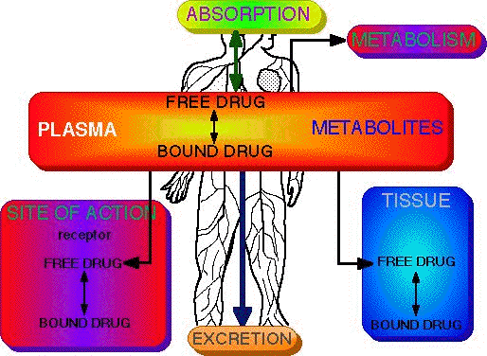
Pharmacokinetic Principles
3 main mechanisms for transport of drugs
Passive Diffusion
Active Transport
Facilitated Diffusion

Slide 20
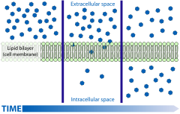
Pharmacokinetic Principles
Passive Diffusion
The drug penetrates the cellular membrane due to the solubility of the drug in the membrane
Lipid soluble drugs diffuse more quickly
Drugs move from areas of higher concentration to lower from inside or outside the cell

Slide 21
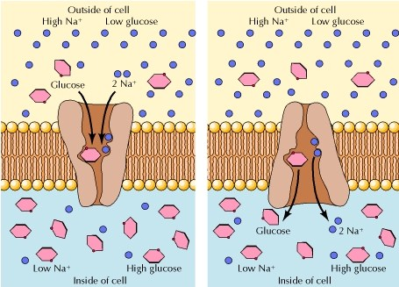
Pharmacokinetic Principles
Active Transport
Active transport mechanisms have a protein with a binding site to which the compound being transported attaches
The advantage of AT is selectivity of compounds for the cell membrane
Plays an important role for the transport of some drugs into the urine or bile

Slide 22
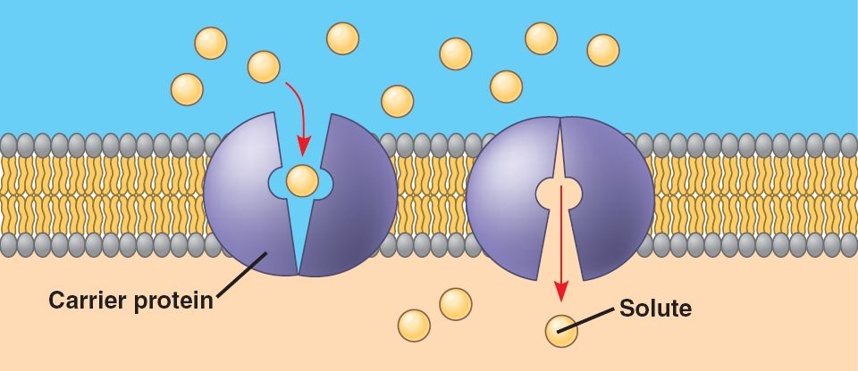
Pharmacokinetic Principles
Facilitated diffusion
Combines the characteristics of passive diffusion and active transport
Requires a carrier protein
Selectivity and system saturation is possible
A high-to-low concentration gradient must be present for net diffusion to occur

Slide 23
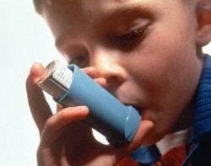
Pharmacokinetic Principles
Routes of drug administration
Which type of drug admin is this?
Oral
  Most common
Sublingual & buccal
  Placed under the tongue or against the cheek
Rectal
  Advantageous for unconscious, vomiting, or young patients
Parenteral
  Intravenous, intramuscular, or subcutaneous
Topical
  Skin, eyes, nose, throat, ears
Inhalation
  Lungs

Slide 24
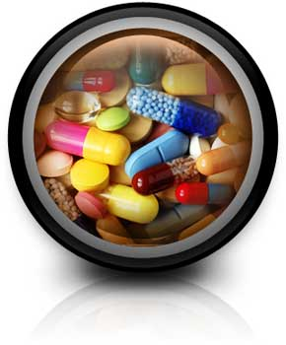
Pharmacokinetic Principles
Purpose of inactive ingredients
Binds drugs together
Increasing the bulk of the tablet
Controlled-release
Tablet survival to GI tract
Enhancing physical appeal of drug

Slide 25
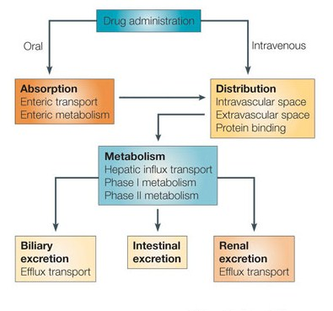
Pharmacokinetic Principles
Metabolism (biotransformation)
Where is kidney metabolism?
The chemical alteration of the drug by one or more enzymes in the body
The liver is primary biotransformation site
Kidney, intestinal cells, lungs, & brain are secondary
Metabolism makes the drug water soluble which is important for excretion

Slide 26

Pharmacokinetic Principles
Drug excretion
Are the Kidneys located more anterior or posterior?
Removal of drugs from the body
Kidney and bile primary routes for excretion
Secondary routes: sweat, saliva, and lungs
BILLARY EXCRETION
drugs pass through the liver into the bile and eventually to the small intestines
Excreted in the feces or reabsorbed into the blood

Slide 27
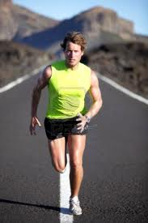
Pharmacokinetic Principles
Potential effects of exercise
Is stomach emptying increased or decreased?
Light exercise decreases stomach emptying
Strenuous exercise increases stomach emptying
Oral absorption is decreased by exercise due to decreased blood flow
Exercise increases the duration of action by drugs cleared by the kidney

Slide 28
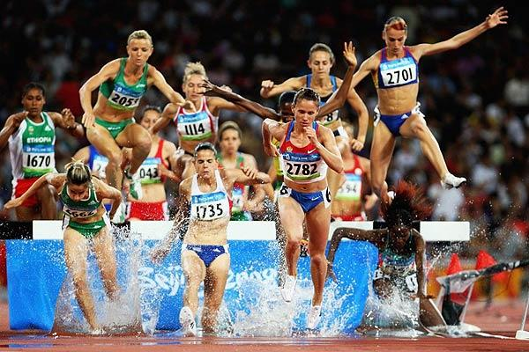
Pharmacokinetic Principles
Potential effect of exercise
Increased or decreased volume of distribution?
Exercise increases the duration of action for drugs that are inactivated by the liver
  An exception to this is protein bound NSAIDs
Sweating decreases the volume of distribution, increasing drugs at the site of action
Long-term exercise may increase metabolism and excretion rates of pharmaceuticals

Slide 29
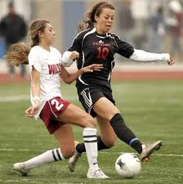
Pharmacokinetic Principles
Potential effect of exercise
Will this have a prominent effect on pharmaceuticals?
Intensive exercise for long duration has the most prominent impact on pharmaceuticals

