Slide 1
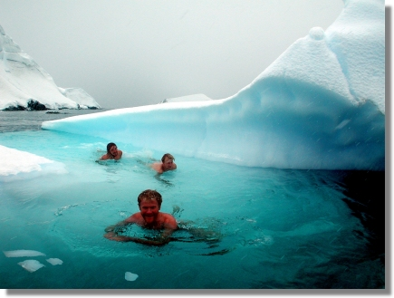
Cryokinetics in Rehabilitation of Joint Sprains

Slide 2
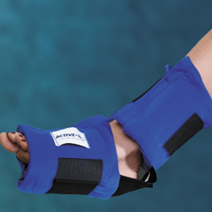
Cryokinetics
Effects
Cold decreases pain
Exercise increases blood flow
Exercise reestablishes neuromuscular function

Slide 3
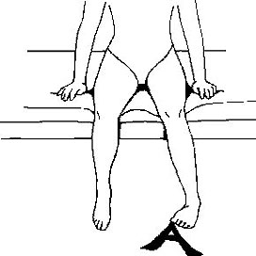
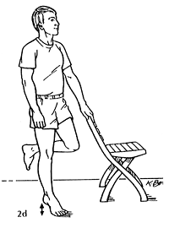
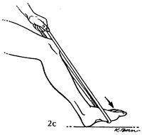
Cryokinetics
Advantages
Cryokinetics allows exercise much sooner than normally would be the case.
Cryokinetics retards muscular atrophy and neural inhibitions.
Cryokinetics reduces swelling dramatically through muscular “milking action”
You can progress at the patient’s speed

Slide 4
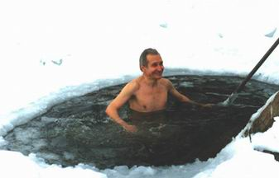
Cryokinetics
Disadvantages
Ice is very painful during the initial ice immersion.

Slide 5
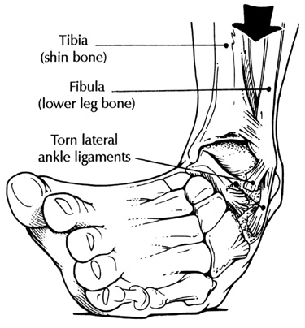
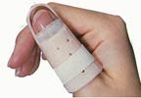
Cryokinetics
Indications
Ankle sprains
Finger sprains
Shoulder sprains
Other joint sprains

Slide 6
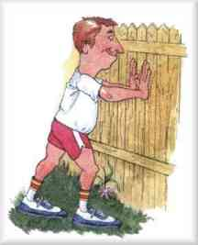
Cryokinetics
Contraindications
Do not perform any exercise or activity that causes pain
Do not use ice on a person who is hypersensitive to cold.

Slide 7
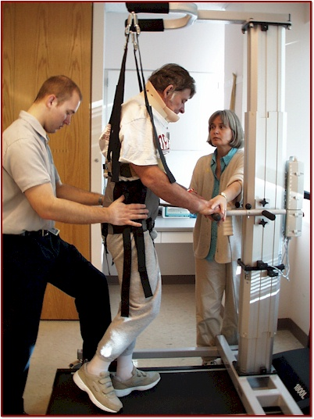
Cryokinetics
Precautions
Pain must be used as a guideline
With lower extremity injuries, patients may limp if not frequently reminded to refrain from limping.
There may be an increase in pain 4 to 8 hours after treatment.

Slide 8
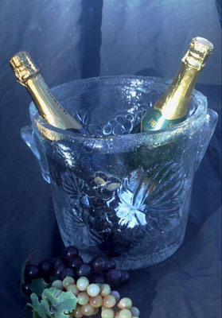
Cryokinetics
Equipment Needed
Slush bucket or ice packs
Toe cap
Towel

Slide 9
Application Procedures
Numb the Body Part
Use ice immersion, ice massage, or cold-pack application
Numbing generally takes 12-20 min.
The patients sensation is more significant than the time of application
Use a toe cap

Slide 10
Application Procedures
Exercise the numbed body part
All exercise should be
Active
Progressive
Pain-free
Exercise should last 2 to 3 minutes, the duration of the numbness
Renumbing takes 3 to 5 min.
Begin with simple rang-of-motion activities and progress through full-sport activity.
With some injuries, progression through full-sport activity will take place in a single treatment session, while with others it may take weeks.

Slide 11
Exercise Progression For an Ankle Strain
Non-weight-bearing range of motion
Weight-bearing
Weight-bearing range of motion
Walking
Strengthening the ankle musculature
Jogging
Hopping and jumping
Sprints
Hopping and sprinting without ice application
Team drills

Slide 12
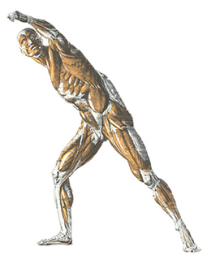
Relieving Acute Muscle Spasm: Cryostretch

Slide 13
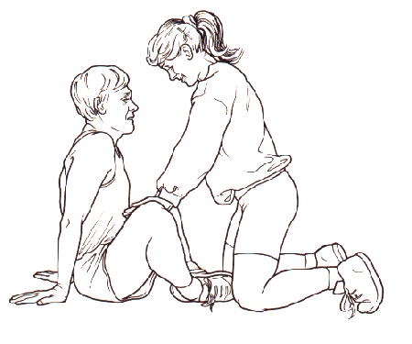
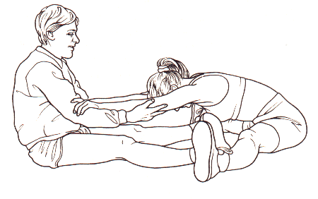
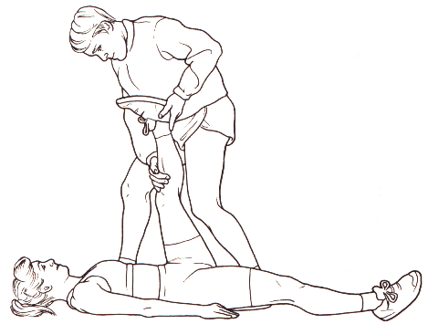
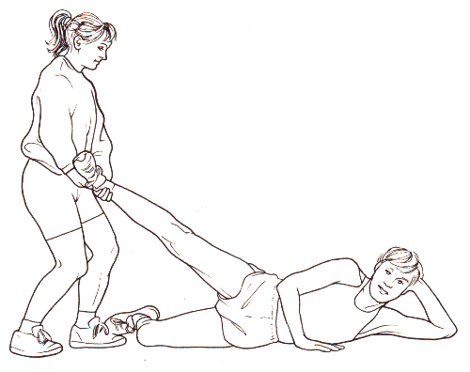
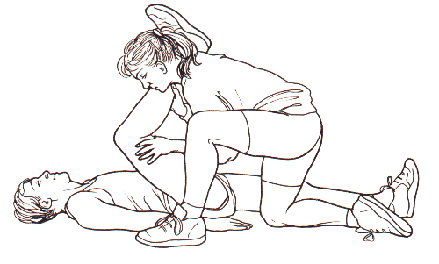
Cryostretch
Combines three techniques for reducing muscle spasm:
Cold application
Static stretching
The hold-relax technique of PNF
Its purpose is to decrease muscle spasm, thereby allowing increased flexibility.
Is similar to cryokinetics in that exercise is performed while the body part is numbed.

Slide 14
Cryostretch
Effects
Ice diminishes pain and muscle spasm
Static stretching overcomes the stretch reflex, decreasing muscle spasm.
Relaxation is often greater after a near-maximal muscular contraction than it was before the contraction.

Slide 15
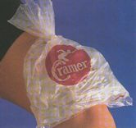
Cryostretch
Advantages
The combination of the three components into one procedure is more effective than any of the parts independently.
Ice is relatively inexpensive; exercise is free.

Slide 16
Cryostretch
Disadvantages
Ice is painful to some people
Melting ice can be messy.

Slide 17
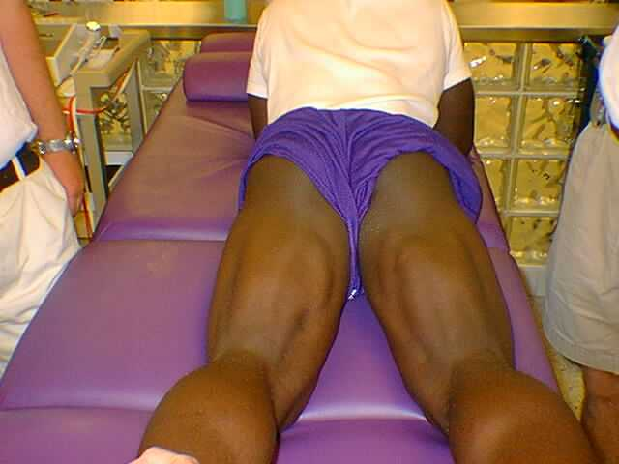
Cryostretch
Indications
Any muscle with residual muscle spasm
First-degree muscle strain
A muscle that is stiff from prolonged disuse (immobilized)

Slide 18
Cryostretch
Contraindications
Do not perform any exercise or activity that causes pain.
Do not use ice on a person who is hypersensitive to cold.

Slide 19
Cryostretch
Precautions
Pain must be used as a guideline. The patient should not attempt to consciously or willfully overcome pain.
There may be an increase in pain 4 to 8 hours after treatment.
Muscles may tear or pull if the static exercise begins too quickly or suddenly. There must be a gradual build-up to a maximal conatraction.

Slide 20
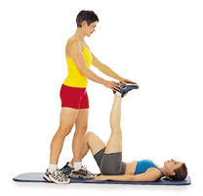
Summary Of Cryostretch Technique
ICE - Until numb (20 minutes maximum)
Exercise Bout
First Stretch Total of 65 sec.
Static stretch 20 sec.
Isometric contraction 5 sec.
Static stretch 10 sec.
Isometric contraction 5 sec.
Static stretch 10 sec.
Isometric contraction 5 sec.
Static stretch 10 sec.
Rest - 20 seconds
Second Stretch (Same as first stretch)
Renumb with 3 to 5 minutes ice application
Exercise Bout
Two stretches (65 sec.) with a 20 sec. rest between stretches
Renumb with 3 to 5 minutes ice application
Exercise Bout
Two stretches (65 sec.) with a 20 sec. rest between stretches

