Slide 1
The basic science of therapeutic modalities
Chapter 1

Slide 2
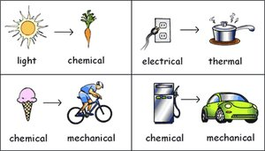
Science of Modalities
energy
Transformed or transferred?
The capacity of a system for doing work and exists in various forms
Often transformed from one form to another
Often transferred from one location to another

Slide 3
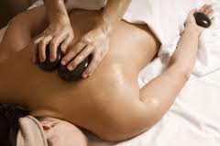
Science of Modalities
energy
What form of energy is this?
Forms of energy relevant for therapeutic modalities
Electromagnetic
Thermal
Electrical
Sound
Mechanical

Slide 4
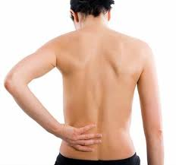
Science of Modalities
energy
Assist, absorb, reflect?
Energy can be transferred into biologic tissue
Tissues may:
Assist to generate heat through resistance
Absorb heat
Reflect energy decreasing the chance of heat

Slide 5
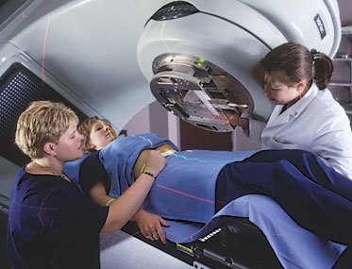
Science of Modalities
Electromagnetic energy
Radiation or Photon?
Radiation
Electromagnetic energy travels from its source outward through space
Heat transfer through which heat can be either gained or lost
Photon
Energy carrier that composes all electromagnetic radiation
Travels as waves at the speed of light

Slide 6
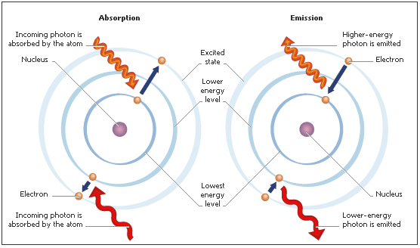
Science of Modalities
Electromagnetic energy
Absorption/emission
Photons all travel at the same speed
Distinguished by their wave properties of wavelength and frequency
Distinguished by the amount of energy carried by each photon

Slide 7
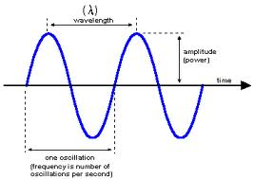
Science of Modalities
Wavelength
vs Frequency
Can the frequency of wavelength be adjusted?
Wavelength
The distance from one point in a propagating wave to the same point in the next wave
Frequency
The number of wave oscillations or vibrations occurring in a particular time unit, commonly expressed in Hertz

Slide 8
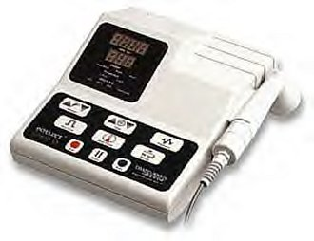
Science of Modalities
Wavelength
vs Frequency
ultrasound
Does US have a wavelength?
Does US have frequency?
Can frequency be adjusted?

Slide 9
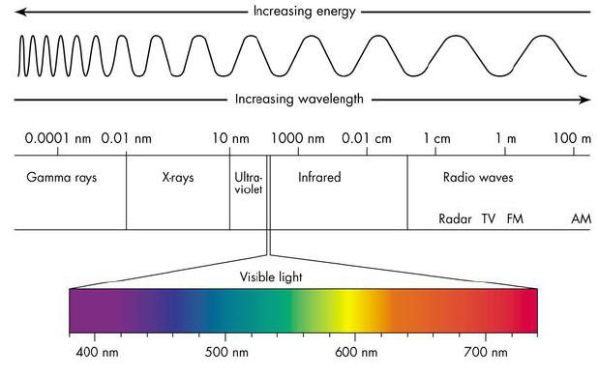
Science of Modalities
Energy spectrum
Colors are called a spectrum
Light refracted through a prism:
Infrared
Red
Orange
Yellow
Green
Blue
Re violet
Ultraviolet

Slide 10
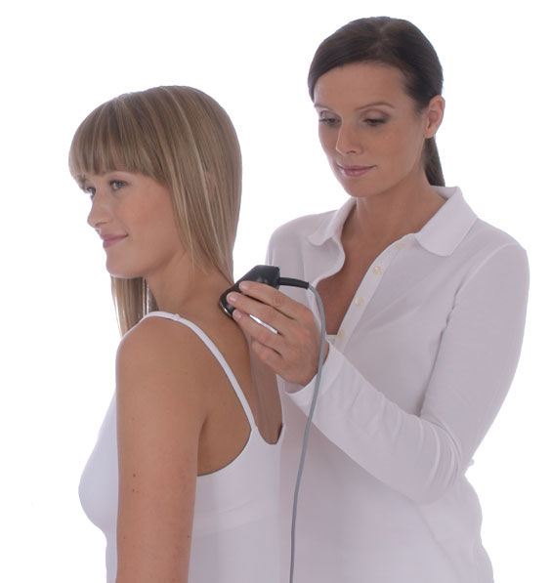
Science of Modalities
Energy spectrum
Is refraction taking place?
Spectrum
Range of visible light colors
Refraction
Change in direction of a wave or radiation wave when is passes from one medium to another

Slide 11
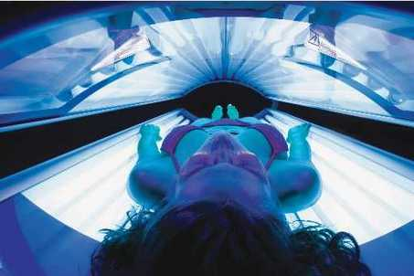
Science of Modalities
Energy spectrum
Infrared or ultraviolet?
Infrared Radiation
The portion of the electromagnetic spectrum associated with thermal changes
Ultraviolet Radiation
The portion of the electromagnetic spectrum associated with chemical changes

Slide 12
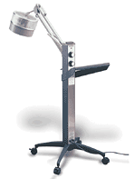
Science of Modalities
Electromagnetic radiations
Diathermy unit
Longer wavelengths more penetrating
Low frequency & long wavelengths heat tissue
Diathermy
The application of high-frequency electrical energy used to generate heat in body tissue as a result of the resistance of the tissue to the passage of energy

Slide 13
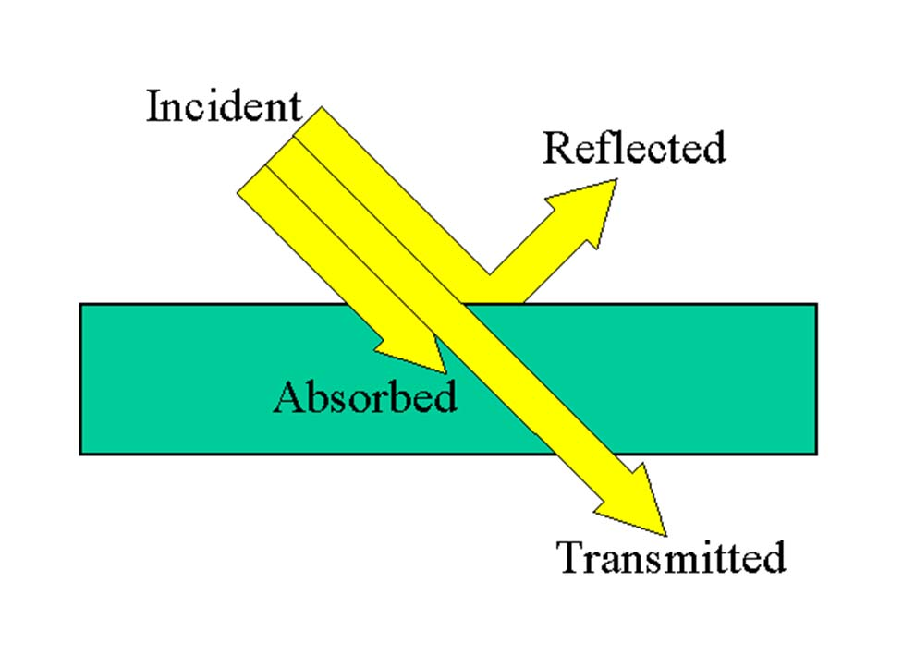
Science of Modalities
Laws of energy
Give an example of each
Reflection
Bending back of light or sound waves from a surface that they strike
Transmission
Propagation of energy through a particular biologic tissue into deeper tissues
Absorption
Energy that stimulates a particular tissue to perform its normal function

Slide 14
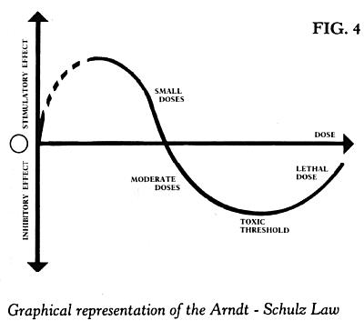
Science of Modalities
Laws of energy
Where is the optimum dose found?
Arndt-Schultz Principle
No reactions or changes can occur in the body if the amount of energy absorbed is not sufficient to stimulate the absorbing tissues
Too little energy: no effect
Too much energy: injury

Slide 15
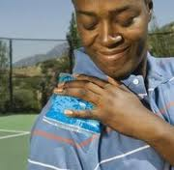
Science of Modalities
Laws of energy
Apply Grotthus-draper
Law of Grotthus-Draper
Energy not absorbed by the tissues must be transmitted
Inverse relationship between absorption and penetration of energy
Energy absorbed by one tissue layer is not passed along to deeper layers
The more energy absorbed in superficial layers, the less available for deeper layers

Slide 16
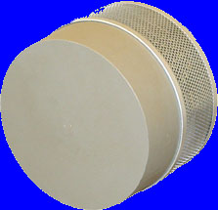
Science of Modalities
Laws of energy
Cosine Law
Angle of incidence: The angle at which radiant energy strikes the body
As the angle of incidence changes from 90º, the less effective the transmission
Based on the cosine of the angle of incidence:
Effective energy = Energy * Cosine (angle)
Radiant energy should be ±90º
45º
50% Transmission
(cosine of 45º = .50)

Slide 17
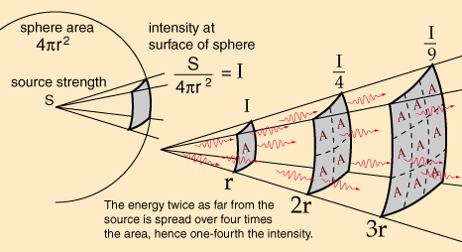
Science of Modalities
Laws of energy
Inverse Square Law
Intensity of radiant energy depends on the distance between the source and the target.
Changing the distance changes the intensity
Change is proportional to the square of the distance.

