Slide 1
Introduction to General Medical Conditions
Chapter 1
Professor Pringle

Slide 2
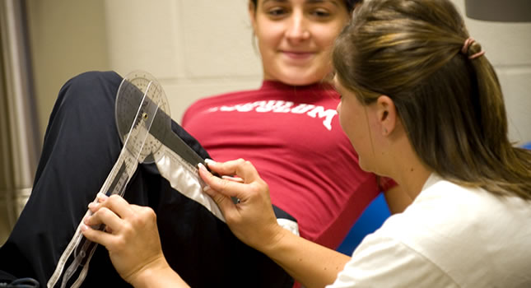
The role of the athletic trainer in general medical concerns
First person to identify medical condition
Pre-established relationship with athlete
Care of orthopedic & non-orthopedic conditions
Broad based knowledge of diagnostic, preventative, rehabilitative medicine

Slide 3
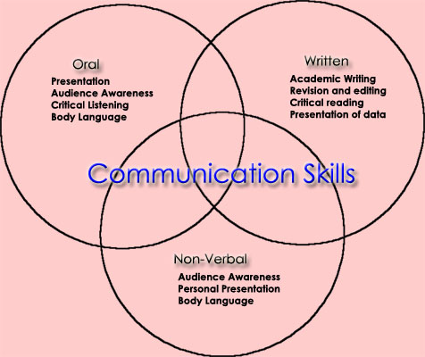
The role of the athletic trainer in general medical concerns
Preparticipation Examination
Communication
Professional
Medical History
Prevention of Disease Transmission
Administration

Slide 4
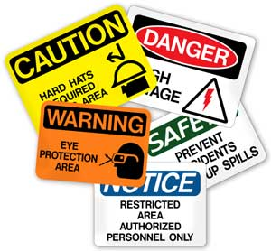
Osha standards for bbp
Establish an exposure control plan
Employers must update the plan annually
Implement the use of universal precautions
Identify and use engineering controls
Identify and ensure the use of work practice controls
Provide personal protective equipment (PPE),
such as gloves, gowns, eye protection, and
Masks
Make available hepatitis B vaccinations to all
workers with occupational exposure
Make available post-exposure evaluation and follow-up to any occupationally exposed worker who experiences an exposure incident
Use labels and signs to communicate hazards
Provide information and training to workers
Maintain worker medical and training records

Slide 5
Legal Considerations – Standard of Care
The watchfulness, attention, caution and prudence that a reasonable person in the circumstances would exercise
If a person's actions do not meet this standard of care, then his/her acts fail to meet the duty of care which all people (supposedly) have toward others
Failure to meet the standard is negligence, and any damages resulting therefrom may be claimed in a lawsuit by the injured party
The problem is that the "standard" is often a subjective issue upon which reasonable people can differ

Slide 6
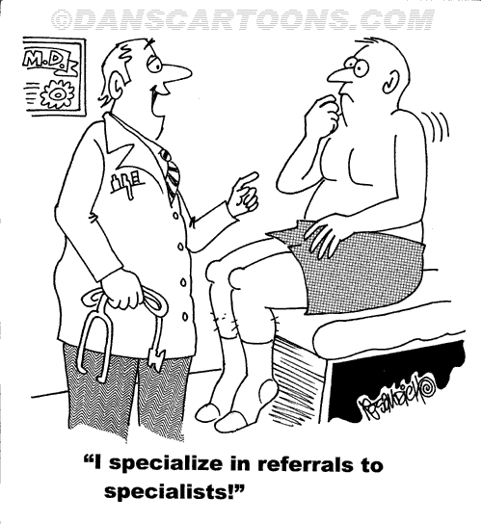
Legal Considerations – Medical referral
The recommendation of a medical or paramedical professional to different or more advanced medical treatment
Who
What
When
Where
Why

Slide 7
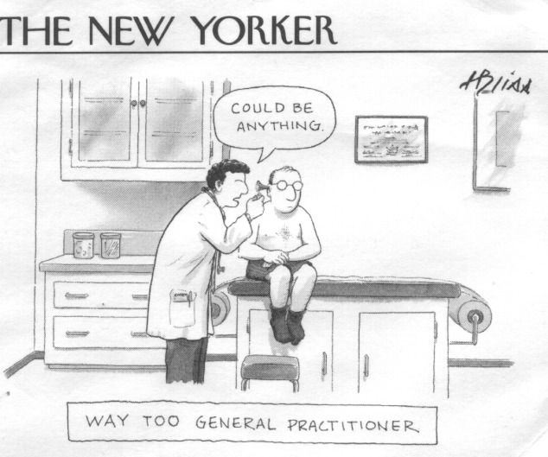
Legal Considerations – Standard of care
Negligence is conduct that falls below a standard of care established by law for the protection of others against unreasonable risk of harm
Actionable negligence requires an injured plaintiff to establish three elements:
A legal duty to use due care
Breach of that duty
A proximate or legal causal connection between the breach and the plaintiff's injuries

Slide 8
Legal Considerations – Medical referral
The recommendation of a medical or paramedical professional

Slide 9
Legal Considerations – Right to privacy
The Office for Civil Rights enforces the HIPAA Privacy Rule
Protects the privacy of individually identifiable health information
The HIPAA Security Rule, which sets national standards for the security of electronic protected health information
The confidentiality provisions of the Patient Safety Rule, which protect identifiable information

Slide 10
Legal Considerations - hippa
Gives patients control over the use of their health information
Defines boundaries for the use/disclosure of health records by covered entities
Establishes national-level standards that healthcare providers must comply with
Helps to limit the use of Personal Health Information (PHI) and minimizes chances of its inappropriate disclosure
Strictly investigates compliance-related issues and holds violators accountable with civil or criminal penalties for violating the privacy of an individual's PHI
Supports the cause of disclosing PHI without individual consent for individual healthcare needs, public benefit and national interests

Slide 11
Legal Considerations - FERPA
FERPA is an acronym for the Family Educational Rights and Privacy Act (also referred to as the Buckley Amendment) and is a federal law designed to:
Protect the privacy of student education records
Establish the right of students to inspect and review their education records
Provide guidelines for the correction of inaccurate and misleading information.
Students Have the Right to:
Inspect and review their education records
Seek to amend their education records when there has been a legitimate error recorded
Have some control over the release of information from their education records
Parental Rights
When a student reaches the age of 18 or begins attending ASC, FERPA rights are transferred to the student.
Parents may obtain directory information at the discretion of the college.
Parents may obtain non-directory information with a signed consent from their child.

Slide 12
Legal Considerations - Medical records
Besides information about physical health, these records may include infomation about family relationships, sexual behavior, substance abuse
Private thoughts and feelings that come with psychotheraphy
Often keyed to a social security number
Information from your medical records may influence your credit, admission to educational institutions, and employment
It may also affect your ability to get health insurance, or the rates you pay for coverage (OTA report)
More importantly, having others know intimate details about your life may mean a loss of dignity and autonomy.

Slide 13
Medical Evaluation Techniques & Equipment
Chapter 2
Professor Pringle

Slide 14
Examination of the athlete
Hand out LMU physical form
Can we improve anything under practical ideal situations
Personnel needed
Equipment needed

Slide 15
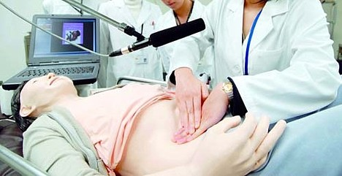
Sounds produced by percussion
http://www.youtube.com/watch?v=HDhkerh6ZZk

